Slide 1
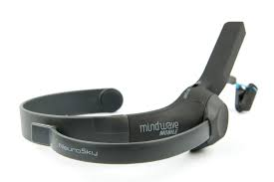
John von Neumann University,
Kecskemét, Hungary
University of Luxembourg
Zsuzsa Buzás & Damien Sagrillo
Why do String Players Perform Easier per Memory than Wind Music Players? – Testing Instrumentalist Students’ Attention Levels During Music Reading

Slide 2
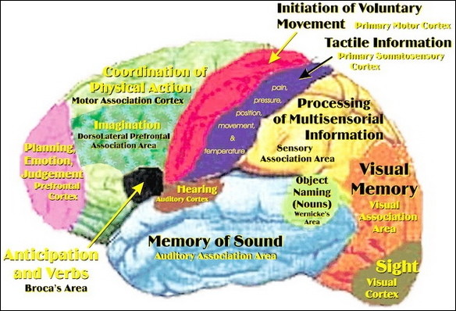
Music and the brain

Slide 3
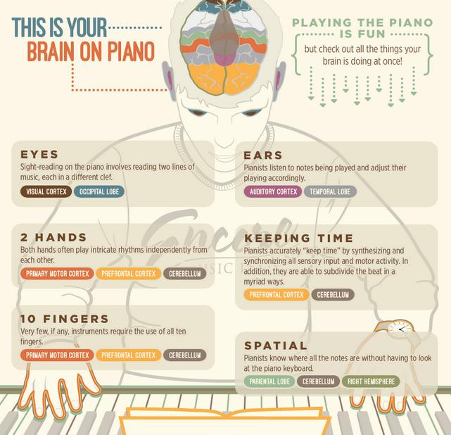

Slide 4
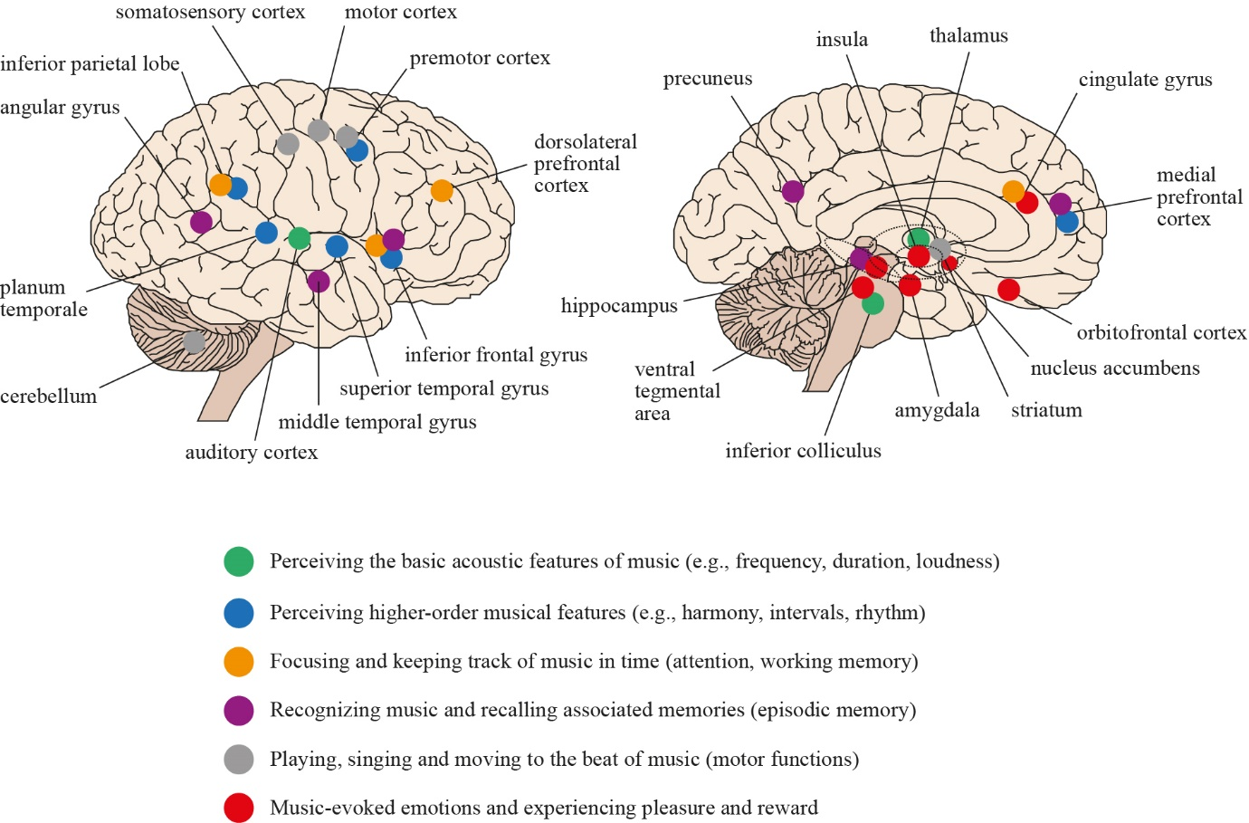
Key brain areas associated with music processing studies of healthy subjects
O’Kelly, Voices, 2016

Slide 5
The concept of music reading
The fast and automated recognition of images and symbols are cognitive factors that determine the development of reading (Csépe, 2014).
The ability to understand and enjoy the music primarily depends on how much we know about the patterns in music and how many associations are involved in the emotional content.
It is essential for the music playing from memory to understand the structures of the compositions, and to know the boundaries of musical phrases and motifs and their connection to the piece (Asztalos & Csapó, 2015).

Slide 6
Effects of musical structure
The development of reading comprehension and the vocabulary are therefore closely related, and reading comprehension requires that the reader understands at least 95% of the words of the text (Schoonen & Verhallen, 1998).
An important characteristic of texts intended for reading is how easily they can be read and the extent to which they are suitable for students as regards the structure of the text and other characteristics.
The readability index is a numeric value expressing how easy a piece of text is to read.
It can be calculated from the length of words and sentences in the text. The easier the text, the higher the value of this number.
The highest possible value of the index is about 120, which would be found for the easiest texts. The texts with a value of 90–100 can be recommended for 10–11-year-old children.
Texts at the other end of the scale are characterized by values below 30 and are suitable for reading by university students.
The Flesch-Kincaid Grade Level provides information about the grade from which students would understand the given piece of text, i.e. from which grade on it can be recommended for reading
Notes:
Kodály Zoltán periódusszerű, pentaton hangkészletből álló olvasógyakorlati megkönnyítik az olvasás folyamatát.
A Flesch-Kincaid Olvasás-index a szövegben szereplő szavak és mondatok hosszúsága alapján számítható ki. Minél könnyebb a szöveg, annál nagyobb ez a szám. Az index lehetséges legmagasabb értéke 120 körül van, ezek a legkönnyebb szövegek. A 90–100 közötti mutatóval rendelkező szövegek javasolhatók a 10–11 éves gyermekek számára. A skála másik végének a szövegei, a 30 alatti értékkel jellemezhetőek, egyetemisták számára alkalmasak olvasásra.
Az interneten keresztül elérhetők olyan oldalak, melyek a bemásolt szövegre kiszámolják ezeket a mutatókat.1 Léteznek további olvashatóság i indexek, például dán, francia, holland, spanyol és svéd szövegekre. Elérhetők olyan on-line szövegszerkesztők is, melyek gépelés közben folyamatosan jelzik a készülő szöveg olvashatósági indexeit.2 Fontos ugyanakkor ﬁ gyelembe venni, hogy ezek az olvashatósági indexe k nem nyújtanak információt a szöveg érthetőségéről, stílusáról, szókincséről. Nem veszik ﬁ gyelembe például a szöveg témáját, tartalmát. Mindemellett fontos mutatók. Szakmai előrelépést jelent majd, ha kidolgozásra kerülnek olyan olvashatósági indexek, melyek a magyar nyelvű szövegek esetében alkalmazhatók. E mutatók mentén is szükséges majd értékelni a hazai tankönyvek, oktatási anyagok, ajánlott olvasmányok stb. szövegeit.
Bár a ﬁ nn és a magyar nyelvű adatok sokféleképpen eltérnek, közös bennük az, hogy a szókincs az olvasással és a dekódolással is korrelál

Slide 7
The role of motivation
The content and the different tasks of music and Solfege textbooks play a prominent role in helping teachers to develop student’s music reading skills.
The diversity, quality, and processing skills of the texts are closely related to the success of reading (Józsa & Steklács, 2012).
The reading motivation of students is of utmost importance, i.e. the kind of texts and methods are used.
Playing music is a beloved activity among instrumentalist students. Frequent reading can thus provide them an increased number of exercise opportunities that can compensate for many years of schooling or the worse socio-economic situation (Guthrie & Wigfield, 2000).

Slide 8
Research fields of music reading
Online assessment
Eye-tracking technology
EEG Elektro Enkefalográf
NeuroSky Mindwave simple - portable device

Slide 9
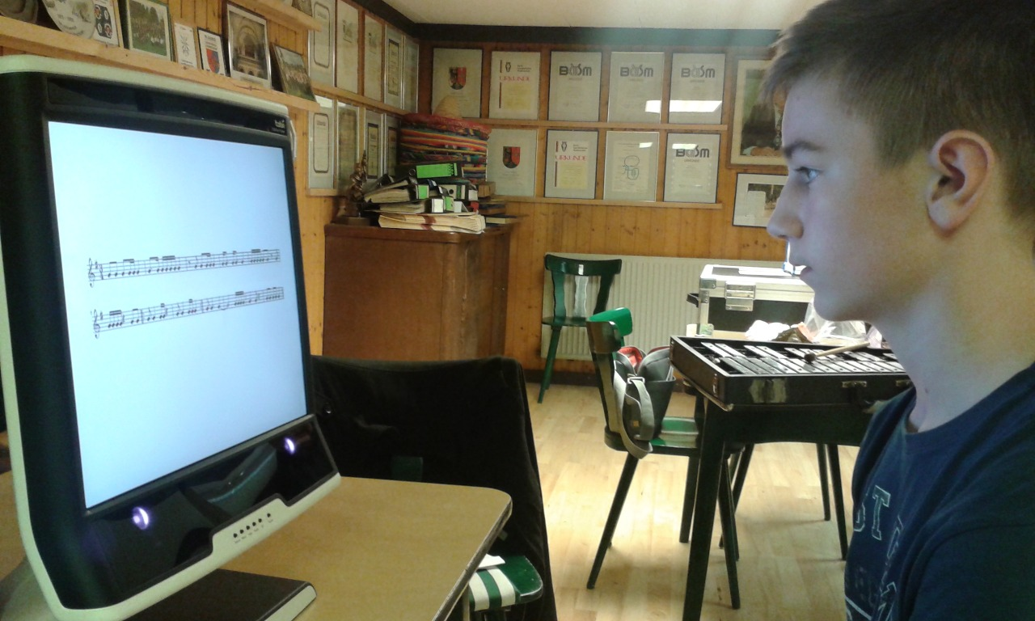
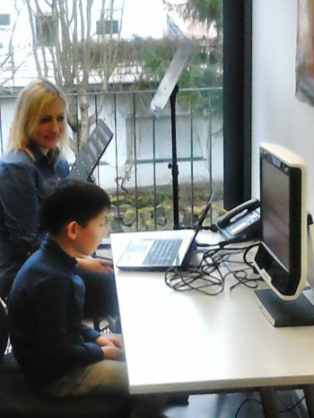

Slide 10
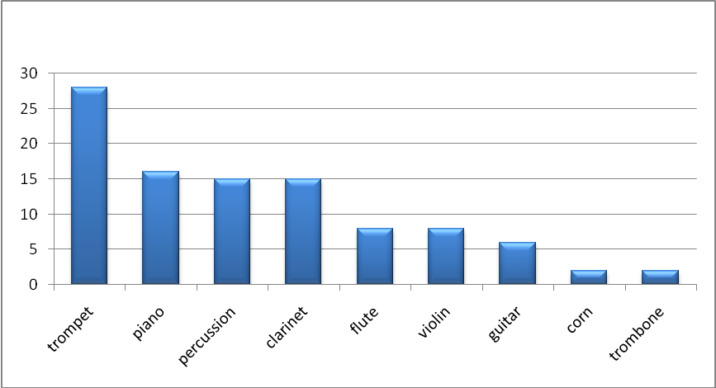
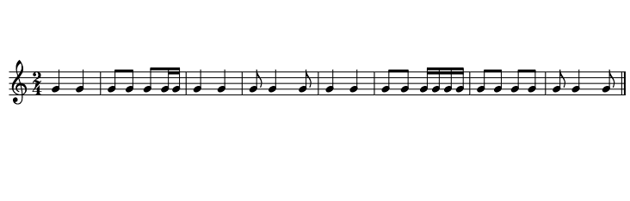
 | Luxembourg N=19 |  | Germany N=16 |  | Hungary N=18 |  | Total
 | boys | girls | boys | girls | boys | girls
10 years | 9 | 5 | 3 | 5 | 6 | 5 | 33
14 years | 3 | 2 | 2 | 6 | 5 | 2 | 20

Slide 11
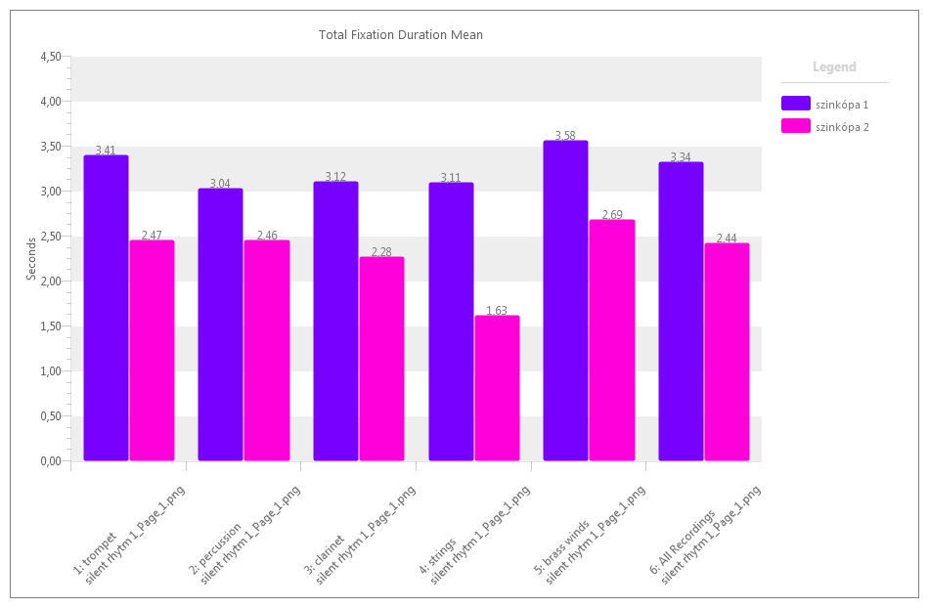

Slide 12
Investigate of students’ attention levels in classroom settings with NeuroSky’s MindWave Mobile (EEG) Device
A general definition of attention is that of the mind focusing on a given activity.
Theory of information processing claims that information first goes through attention and selective perception before its transfer to sensual recording, short-term memory, and long-term memory.
Attention can therefore be claimed to be a prerequisite to learning (Schunk, 2009) and a factor that facilitates it (Kruschke, 2000; Schmidt, 2001).

Slide 13
EEG device that translates brainwaves into digital information and beams it wirelessly to the computer.
NeuroSky’s MindWave was developed directly as a biosensor to read the electric activities of the brain in detecting its states of attention and relaxation.
As pedagogical neurofeedback it is used to increase the students` capabilities in controlling their attention and concentration in learning situations.
Class participation and attention levels affect student motivation, & a highly motivated student displays high levels of attention and class participation (Fidan, 1996; Schunk, 2008).
Class participation is crucial in that it raises the quality of learning.
There exist a moderate, positive correlation between students’ attention levels and class participation (Sezer et al., 2017).

Slide 14
Flow was examined during learning performance, it depends on the challenge-skill balance of learning materials (Wang, 2014).
Test the possibility of multiple readings of students’ attention levels in real classroom settings by means of NeuroSky’s MindWave EEG device. Powerpoint presentation, digital maps used in lesson increase students’ attention levels, & lectures without any teaching material decrease their attention levels (Sezer, et al.).
Yang, Chang, Chien, Chien, and Tseng (2013) PowerPoint presentations raise students’ attention levels.

Slide 15
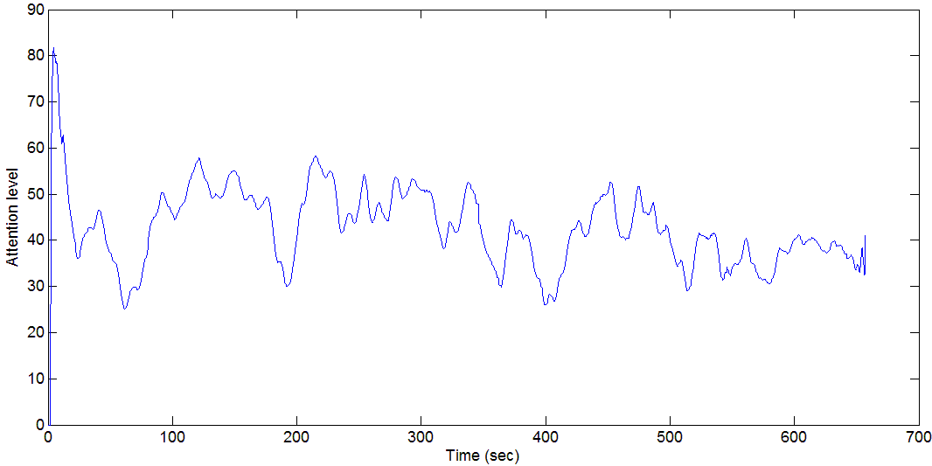
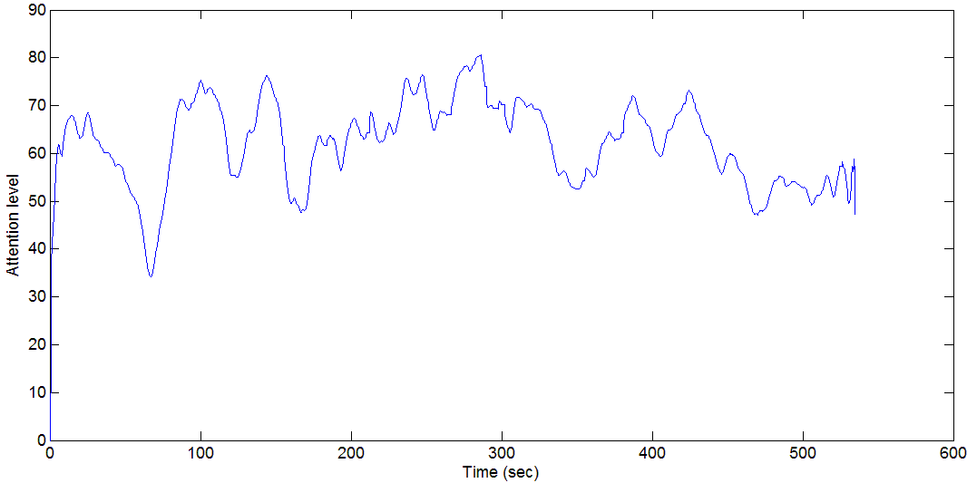
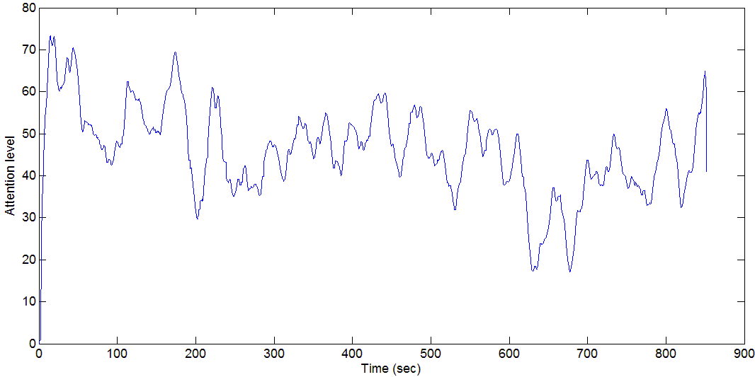
A smoothed attention level record can be seen. We received quite noisy signals because of high sampling rate, that’s why the smoothing. At „break downs” we recorded the student changed among exercises.
The other student needed much more attention to finish the exercises.
Attention level changes when switching exercises
Most significantly the fatigue was recognized when pianists playing a sheet music.
Fatigue can be detected

Slide 16
EEG Bandwidth and corresponding mental state and condition
Type Frequency (Hz) Mental state and conditions
Delta 0-3.5 Deep, sleep, non-REM sleep, unconscious
Theta 4 – 7 Intuitive, recall, fantasy, imaginary, dream
Alpha 8 - 12 Relaxed, but not drowsy, tranquil, conscious
Beta Low 13- 15 Relaxed yet focused, integrated
Mid. 16 – 20 Thinking, aware of self & surroundings
High 21 - 30 Alertness, agitation
Gamma >31 Motor functions
The EEG device captures the brain waves in the Beta interval, produces an original value, and scales it between 1 and 100. Natural state is between 40 and 60.
20-40 is slightly low.
60 to 80 is slightly high.
80 to 100 is very high.
Notes:
The device used in the study captures the brain waves in the Beta interval, produces an original value, and scales it between 1 and 100. In this scale, the results of the data analysis were evaluated with the manufacturer’s e-Sense Metric. According to this metric, attention
and meditation data is scaled between 1 and 100.
According to the scale, natural state, or the floor, is between 40 and 60. 60 to 80 is slightly high and 80 to 100 is very high. Likewise, 20 to 40 is slightly low and 0 to 20 is very low. The low parts are due to extraordinary circumstances, attention deficit, and excitement (MindWave User Guide, 2009).

Slide 18
Research
The study aims to test instrumentalist students’ attention and mediation levels during music reading by means of NeuroSky’s MindWave EEG device.
We investigated wind instrumentalists, 12-14 years of age, and compared them with violin players matched for age and grade level.
The research was carried out in 2 music schools in March 2018 (Dr. Márta Janurik)
Students were asked to play an eight-bar composition of Szilvay – Colour String Method, based on the Kodály concept.
We analyzed attention and mediation levels, blinks (alpha, beta and gamma band oscillatory responses) to the musical piece during reading.

Slide 19
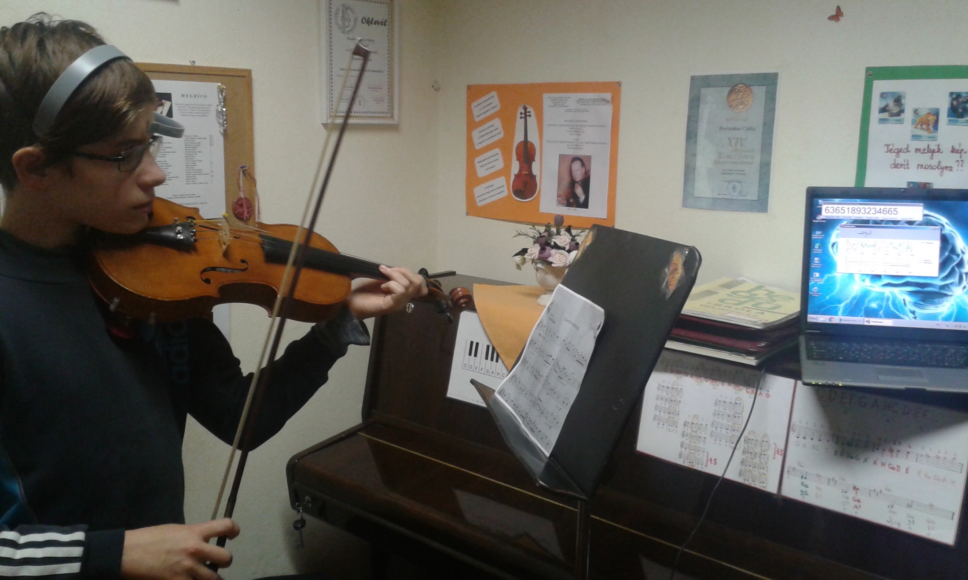

Slide 20
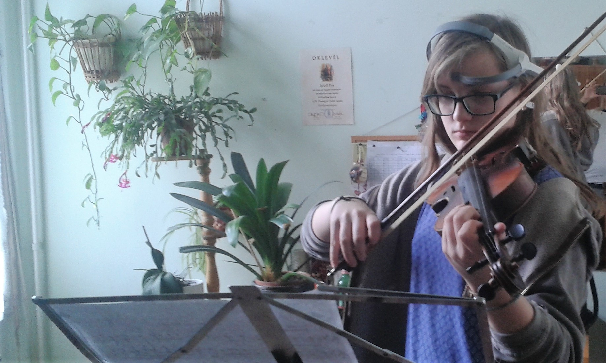

Slide 21
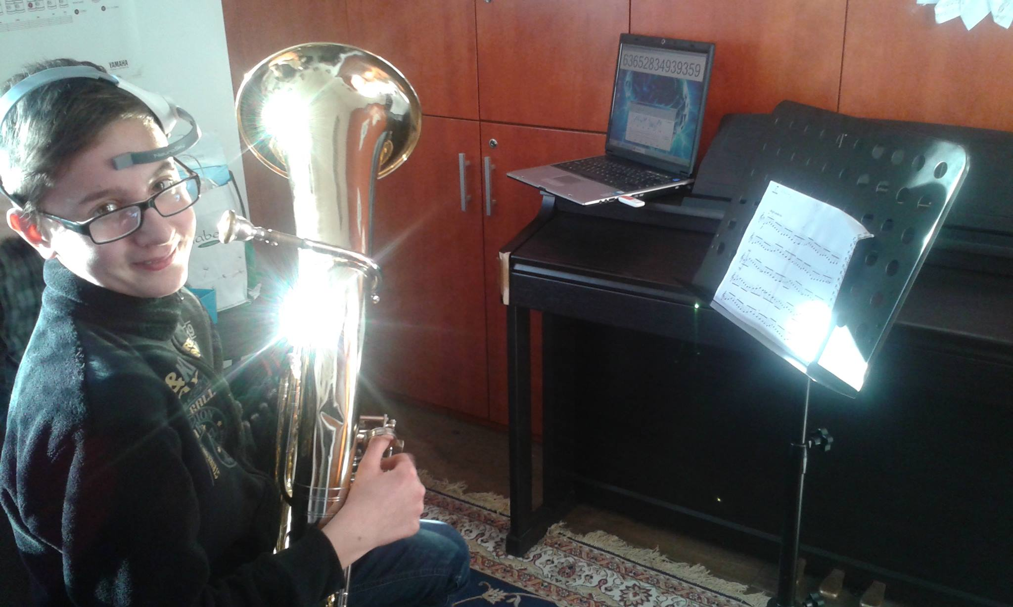

Slide 22
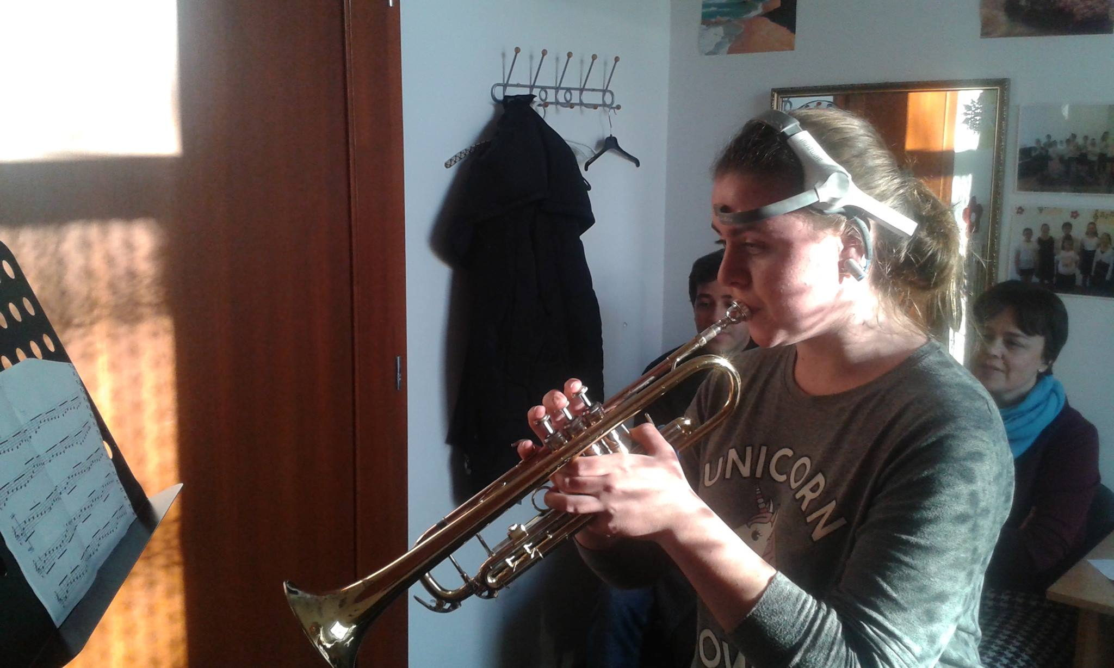

Slide 23
Results
Attention and meditation data is scaled between 1 and 100.
The findings from the study revealed that the average of the attention levels of the violin players was slightly high; 61.53.
The attention level of the wind players was 39.98, that is slightly low.
Significant difference was found between the averages of attention level between the string and the wind players (t=2.656, p=0.026).

Slide 24
 | Instrument | N | Mean
Attention | violin | 21 | 61.53
 | trumpet | 18 | 41.41
 | tenorhorn | 2 | 34.27
 | Total | 41 | 52.55
 | Instrument | N | Mean
Mediation | violin | 21 | 54.01
 | trumpet | 18 | 50.56
 | tenorhorn | 2 | 58.54
 | Total | 41 | 53.24
 | Instrument | N | Mean
Blink | violin | 21 | 53.53
 | trumpet | 18 | 49.78
 | tenorhorn | 2 | 44.90
 | Total | 41 | 51.56

Slide 27
During playing | N | Mean | SD | Min. | Max.
Attention | 41 | 60.43 | 61.53 | 42.02 | 69.91
Mediation | 41 | 59.88 | 4.76 | 54.51 | 67.63
Silent reading
Attention | 41 | 56.99 | 21.96 | 32.54 | 81.30
Mediation | 41 | 44.96 | 12.51 | 44.96 | 80.48
 | Gender | Mean | SD
Silent reading attention | Girls | 37.41 | 6.89
 | Boys | 66.78 | 20.13
Silent reading mediation | Girls | 60.99 | 2.21
 | Boys | 57.40 | 15.92

Slide 29
Conclusions & directions for future research
There are differencies in the attention and concentration level during silent and loud music reading among different instrumentalist – similar to the results of eye-tracking research
Differencies between gender and age groups.
Developing training programs of music reading comprehension based on the level of attention, and motivation.
Notes:
Extending online music reading testing across different countries can increase the generalizability of the results. The online platform makes it possible to bridge distances. We tested the music reading skills of primary school students in Luxembourg with an online music test in German. The Spanish version is being developed now.

Slide 30
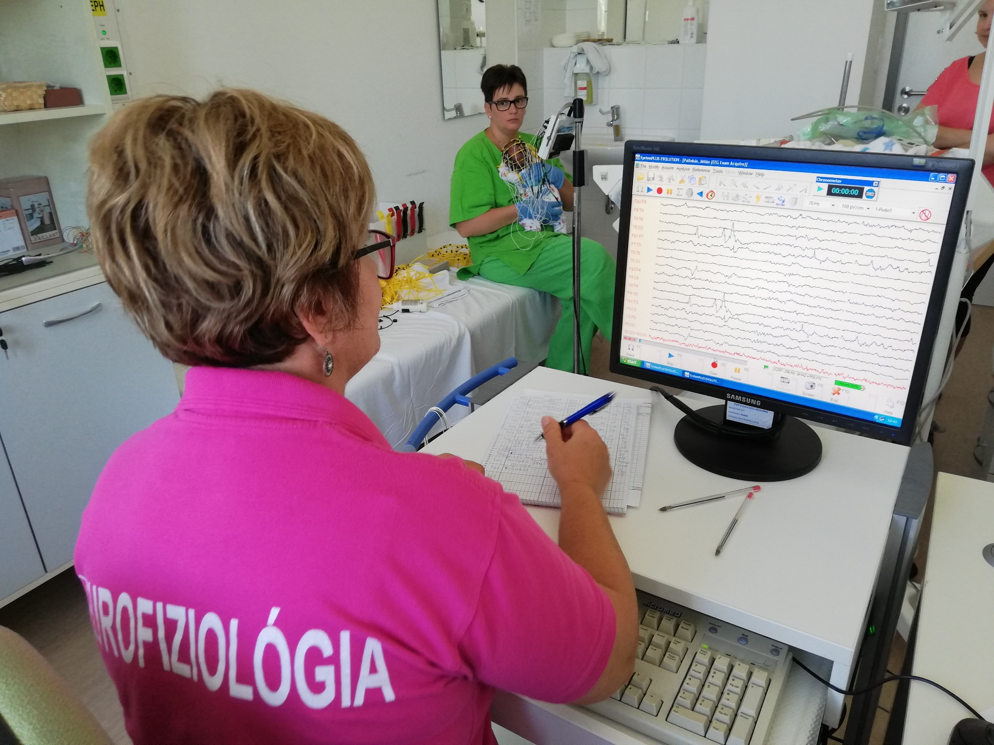
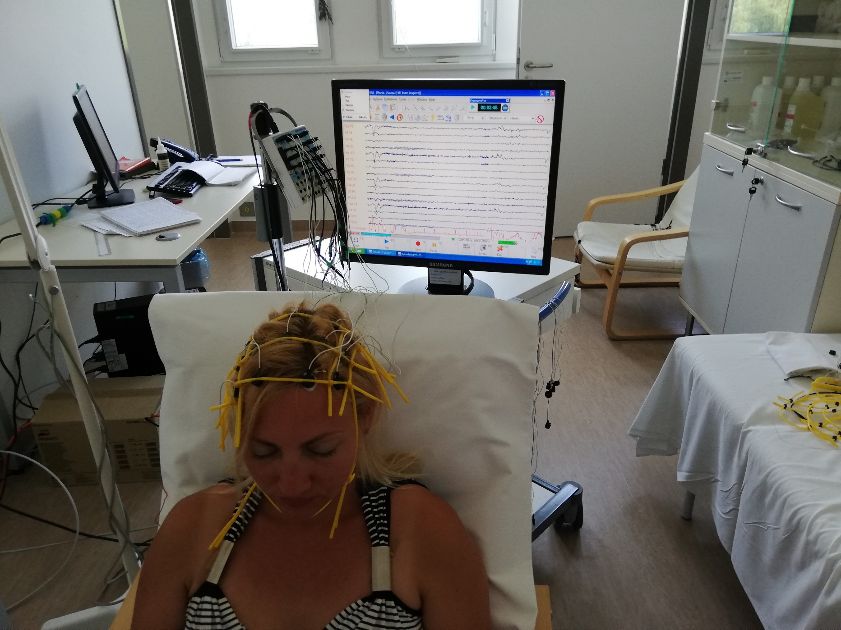

Slide 31

Thank you for your kind attention!

