Slide 1

Music education (ME) in general schools
Teachers and their Anxiety Facing the Task?
Damien Sagrillo, Université du Luxembourg
Kecskemét, 10 April 2019

Slide 2
Overview
The Anxiety Facing the Task
The Categories of “Disciplinarities”
Methodology
Conclusions

Slide 3
The Anxiety Facing the Task
How does it manifest itself?
How to (re)establish confidence?
“Sing with me. Sing by yourself. Make your own music. Pick up a guitar, or just sing a cappella. We don’t need professional singers. We don’t need stars. You sing. Join me now. …”
        Hajdu 2001, p. 8
Notes:
Comment elle se manifeste? La peur de s’exposer
Exemples uni.lu => la peur de se montrer et de se produire devant la publique, devant une classe et de préparer une chanson d’après la méthode perroquet (« Papageienmethode »), selon laquelle une chanson est apprise après audition de l’enseignant et l’imitation par les élèves.
David Hajdu, Positively 4th Street: The Lives and Times of Joan Baez, Bob Dylan, Mimi Baez Fariña and Richard Fariña. 2001
https://books.google.fr/books?id=t4I1CQyVFkEC&pg=PA8&lpg=PA8&dq=%22you+can+sing.+join+me+now%22&source=bl&ots=D3zM79Ekb6&sig=ACfU3U1qmAacUMkzKVnFvYRvMX6NtLmEag&hl=de&sa=X&ved=2ahUKEwjX4OfRoKDhAhXE3KQKHRNPCu8Q6AEwAHoECAMQAQ#v=onepage&q=%22you%20can%20sing.%20join%20me%20now%22&f=false

Slide 4
The Anxiety Facing the Task
The reasons:
  ME for specialist teachers
  Lack of music reading skills
  Unfavourable learning context
  Lack of confidence in age groups around adolescence
        Holden/Button 2006, p. 29
General teachers feel the lowest in giving music lessons

Slide 5
The Anxiety Facing the Task
Generalist teacher or specialist teacher?
  In some countries, specialists are not welcome!*
  The generalist teacher lacks musical background!?
  The idea of the coordinator in ME
        Holden/Button 2006, p. 24-25
Notes:
“Does the non-specialist teacher have the subject knowledge, confidence and expertise to develop and promote music to the ‘high standard’ required by the National Curriculum?”

Slide 6
The Anxiety Facing the Task
Symptoms?
  Difficulties in teaching composition and notation
  Intimidated of being forced to sing
        Holden/Button 2006, p. 32–33
  Preference of activities such as music listening and all activities which allow to stay passive

Slide 7
ME and Categories of “disciplinarities”
Music education (ME) is a school subject!
to which can be added
Transdisciplinarity
Pluri- / multidisciplinarity
Music as a means to achieve an extra-musical objective
“Intradisciplinarity”*
Notes:
Intradisciplinarité: Learning within the subject of music, such as rhythmics, dance, the performing arts, the performing arts, the stage, etc.

Slide 8

Transdisciplinarity
        Éducation musicale et interdisciplinarité 2016, p. 2
Notes:
Éducation musicale et interdisciplinarité, p. 2
http://cache.media.eduscol.education.fr/file/Education_musicale/01/2/RA16_C4_EMUS_educ_mus_interdiscipline_V2_658012.pdf
My example: The film Amadeus (Musical Theme)
Mozart's biography and life in the second half of the 18th century => mobilization of knowledge from other disciplines, here history, dramaturgy (the mix between reality and fiction)
(Mozart in contact with the Emperor of Austria. Who was the emperor of Austria in Mozart's time? It was Joseph II, (1741-1790))

Slide 9
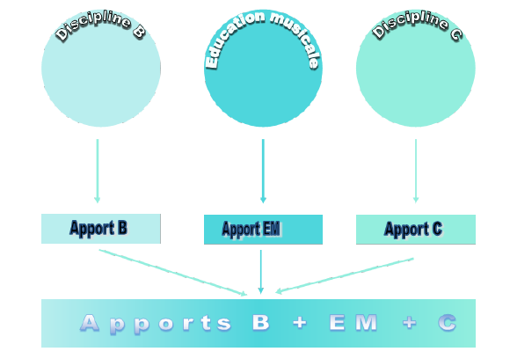
Pluridisciplinarity
        Éducation musicale et interdisciplinarité 2016, p. 5
        Crisciuc / Cosumov 2017, p. 38
Notes:
Éducation musicale et interdisciplinarité, p. 3
http://cache.media.eduscol.education.fr/file/Education_musicale/01/2/RA16_C4_EMUS_educ_mus_interdiscipline_V2_658012.pdf
ME&Transdisc.pdf: TRANSDISCIPLINARY DIMENSIONS OF MUSIC EDUCATION:
TERMINOLOGICAL AND CONCEPTUAL APPROACHES
Viorica Crisciuc13, Marina Cosumov14
Review of Artistic Education no. 13 2017 37-42
Crisciuc / Cosumov 2017
Sagrillo ‘La Grande Guerre et ses chansons.’ „La chanson de Craonne“ und „Quand Madelon“ als Spiegelbilder einer Nation im Krieg, in Militärmusik im Diskurs. Schriftenreihe des Miltärmusikdienstes der Bundeswehr. Militärmusik und Erster Weltkrieg (2015)
My example: Knowledge about the First World War (general theme, not related to a specific discipline)...
... its songs by contributing knowledge of three themes that interact
Contribution B: historical events and the situation: hairy people in the trenches,
Contribution C: the lyrics of the song, 1,500 songs, wide thematic range from patriotism, satire, melancholy, separation of partner, glorification of hairy / defamation of opponents
EM contribution: the melody of the song

Slide 10
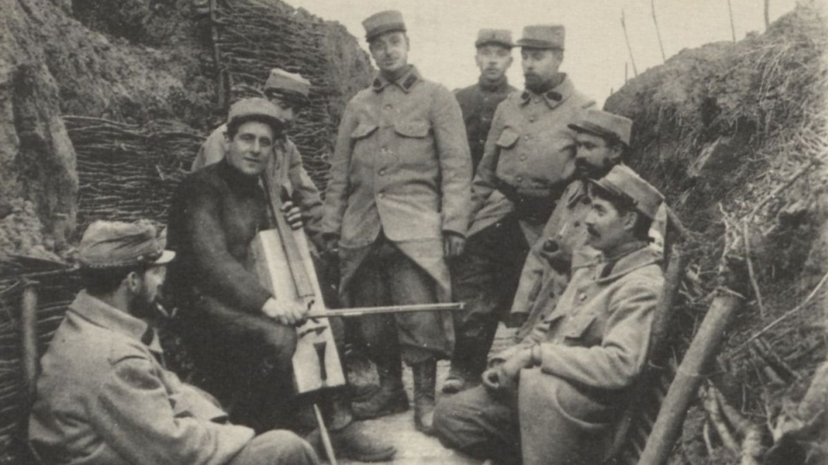
Notes:
Un projet pluridisciplinaire à l’école primaire autour de la musique
http://centenaire.org/fr/print/546

Slide 11
La pluridisciplinarité
        Éducation musicale et interdisciplinarité 2016, p. 3
        Crisciuc / Cosumov 2017, p. 37
Notes:
Éducation musicale et interdisciplinarité, p. 3
http://cache.media.eduscol.education.fr/file/Education_musicale/01/2/RA16_C4_EMUS_educ_mus_interdiscipline_V2_658012.pdf
Sagrillo ‘La Grande Guerre et ses chansons.’ „La chanson de Craonne“ und „Quand Madelon“ als Spiegelbilder einer Nation im Krieg, in Militärmusik im Diskurs. Schriftenreihe des Miltärmusikdienstes der Bundeswehr. Militärmusik und Erster Weltkrieg (2015)
Mon exemple: Les savoirs sur la 1ère Guerre Mondiale …
… ses chansons par l’apport de connaissances de trois thématiques qui interagissent
Apport B: les évènements historiques et la situation: les poilus dans les tranchées,
Apport C: les textes de la chanson, 1’500 chansons, vaste éventail thématique allant de patriotisme, satire, mélancholie, séparation du partenaire, glorification de poilus / diffamation des adversaires
Apport EM: la mélodie de la chanson

Slide 12
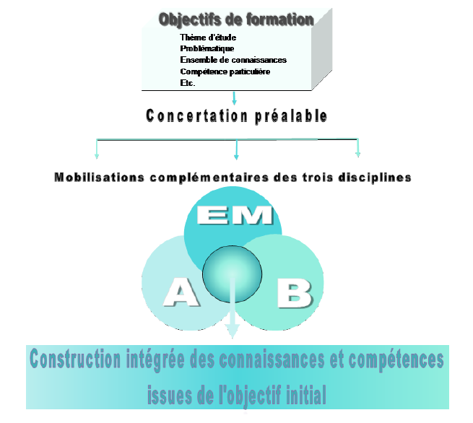
Interdisciplinarity
        Éducation musicale et interdisciplinarité 2016, p. 3
        Crisciuc / Cosumov 2017, p. 37
Orientation towards the outcome
Openness to metacognitive skills such as
  Decision-making authority
  Problem solving
  Effective learning technics
        Crisciuc / Cosumov 2017, p. 38
Notes:
Approche holistique en vue d’appréhender un sujet
« dialogue des savoirs et des méthodes disciplinaires autour d’un même objet »**
« valorisation de la pluralité ainsi que la diversité des savoirs et des méthodes »**
Implication personnelle; la concertation préalable entre enseignants
yyy
*Éducation musicale et interdisciplinarité, p. 5
http://cache.media.eduscol.education.fr/file/Education_musicale/01/2/RA16_C4_EMUS_educ_mus_interdiscipline_V2_658012.pdf
**Contribution critique au développement des programmes d’études : compétences, constructivisme et interdisciplinarité
Philippe Jonnaert,
Johanne Barrette,
Samira Boufrahi et
Domenico Masciotra

Slide 13
“Disciplinarities”
These approaches
  Provide opportunities and do not constitute obstacles for non-specialised teachers
  Enable education to transcend school subjects and avoid hyperspecialisation that can lead to a certain isolation
“The fundamental objective of any educational system is to offer the students general education.”
        Crisciuc / Cosumov 2017, p. 41

Slide 14
“Disciplinarities”
Musical breaks
Knowledge
Musical
To write to music
“Monodisciplinarity”
Music
Education
To practice music
To listen music
Social impact
To paint music
To learn languages
To create Music
Setting to music (Haikus)
Music and concentration
Music and emotions
Notes:
Jouer de la musique
Rythme
Mouvement et danse
Chanter
Jouer d’un instrument
Les savoirs
Instruments
Compositeurs
Histoire de la musique
L’écoute musicale
Créativité musicale
Composition
KiT
Ces multiples approches, un problème* ou une issue?
*Beaucoup ne prennent la branche musique pas au sérieux. Et, hélas, la réalité leur donne souvent raison. Nous refusons aux enfants et aux adolescents des succès d’apprentissages musicales, en les sollicitant de façon paradoxale insuffisamment par une pléthore thématique
(Jank / Stroh)

Slide 15
“Disciplinarities” – Problems of viewpoint
Example: Haikus
Transdisciplinary approach
To set to music
To paint
Haiku
To write to music
Notes:
Éducation musicale et interdisciplinarité
http://cache.media.eduscol.education.fr/file/Education_musicale/01/2/RA16_C4_EMUS_educ_mus_interdiscipline_V2_658012.pdf
Mon exemple: Le film Amadeus
La biographie de Mozart et la vie dans la 2e moitié du 18e siècle
=> mobilisation de savoirs relevant d’autres disciplines, ici l’histoire
Mozart en contact avec l’empereur d’Autriche. Qui était l’empereur d’Autriche dans le temps de Mozart? C’était Joseph II, (1741-1790)

Slide 16
“Disciplinarities” – Problems of viewpoint
Example: Haikus
To set to music
To write a haiku (language)
To paint a haiku (visual arts)
Interdisciplinary viewpoint
Haiku
Notes:
Éducation musicale et interdisciplinarité
http://cache.media.eduscol.education.fr/file/Education_musicale/01/2/RA16_C4_EMUS_educ_mus_interdiscipline_V2_658012.pdf
Mon exemple: Le film Amadeus
La biographie de Mozart et la vie dans la 2e moitié du 18e siècle
=> mobilisation de savoirs relevant d’autres disciplines, ici l’histoire
Mozart en contact avec l’empereur d’Autriche. Qui était l’empereur d’Autriche dans le temps de Mozart? C’était Joseph II, (1741-1790)

Slide 17
“Disciplinarities” – Problems of viewpoint
Example: Haikus
Multidisciplinary viewpoint
To write
To set to music
To paint
VA
ME
Language
Haiku written, set to music, painted
Notes:
Éducation musicale et interdisciplinarité
http://cache.media.eduscol.education.fr/file/Education_musicale/01/2/RA16_C4_EMUS_educ_mus_interdiscipline_V2_658012.pdf
Mon exemple: Le film Amadeus
La biographie de Mozart et la vie dans la 2e moitié du 18e siècle
=> mobilisation de savoirs relevant d’autres disciplines, ici l’histoire
Mozart en contact avec l’empereur d’Autriche. Qui était l’empereur d’Autriche dans le temps de Mozart? C’était Joseph II, (1741-1790)

Slide 18
Methodology
109 Works of students analysed
  69 Projects in teaching-learning-workshops (LLW)
  35 Theses
Subdivision in five categories including and transcending « disciplinarities »
Notes:
109 Student works analysed between 10/11 and 18/19
Teaching-learning-workshops (LLW)
Choice between VA and ME
Priority is given to VA => Anxiety Facing the musical Task?
About 4-6 theses with musical themes out of 100 per year
Among all the topics and school subjects concerning general education at the GD of Luxembourg

Slide 19
ME as a means of achieving an extra-musical objective beyond transdisciplinarity?
Students' favourite themes
  The beneficial social effect
    Classroom climate
        Bastian 2001
  Music and emotions
  Music and concentration
  Musical breaks during the school day
  Language learning

Slide 20
Results: Theses - choice of topics
THESES
Transdisciplinarity | 2 | 6%
Multidisciplinarity | 5 | 14%
Music as a means of achieving an extra-musical objective | 18 | 51%
“Intradisciplinarity” | 3 | 12%
Music as a school subject | 7 | 28%
 | 35

Slide 21
Results: Theses - choice of topics
Projects in teaching-learning-workshops (Lehr-Lern-Werkstatt)
Transdisciplinarity | 9 | 13%
Multidisciplinarity | 25 | 36%
Music as a means of achieving an extra-musical objective | 24 | 35%
“Intradisciplinarity” | 3 | 4%
Music as a school subject | 8 | 12%
 | 69

Slide 22
Results: Theses and projects
OVERVIEW
Transdisciplinarity | 11 | 11%
Multidisciplinarity | 30 | 29%
Music as a means of achieving an extra-musical objective | 42 | 40%
“Intradisciplinarity” | 6 | 6%
Music as a school subject | 15 | 14%
 | 104

Slide 23
Conclusions
Music lessons ≠ Singing before/with students: anxiety facing the task
Unpopular “intradisciplinary” music course: anxiety facing the task
Music as a means of achieving an extra-musical objective, a more important category than "disciplinarities"

Slide 24
Conclusions
Music as a school subject is an unattractive discipline, but bears possibilities for practical projects

Slide 25
Conclusions
Is a generalist teacher more oriented towards transdisciplinarity?
  Is transdisciplinarity as a chance to overcome anxiety?...
    2/3 in favour
        Holden/Button 2006, p. 32
  … at the detriment of classical music lessons
    ≠ “I can't do Music – so we just sing”
        Davies (1984)
Notes:
Davies, C. (1984) 'I can't do Music – so we just sing,' in C. Aubrey (Ed, 1994):

Slide 26
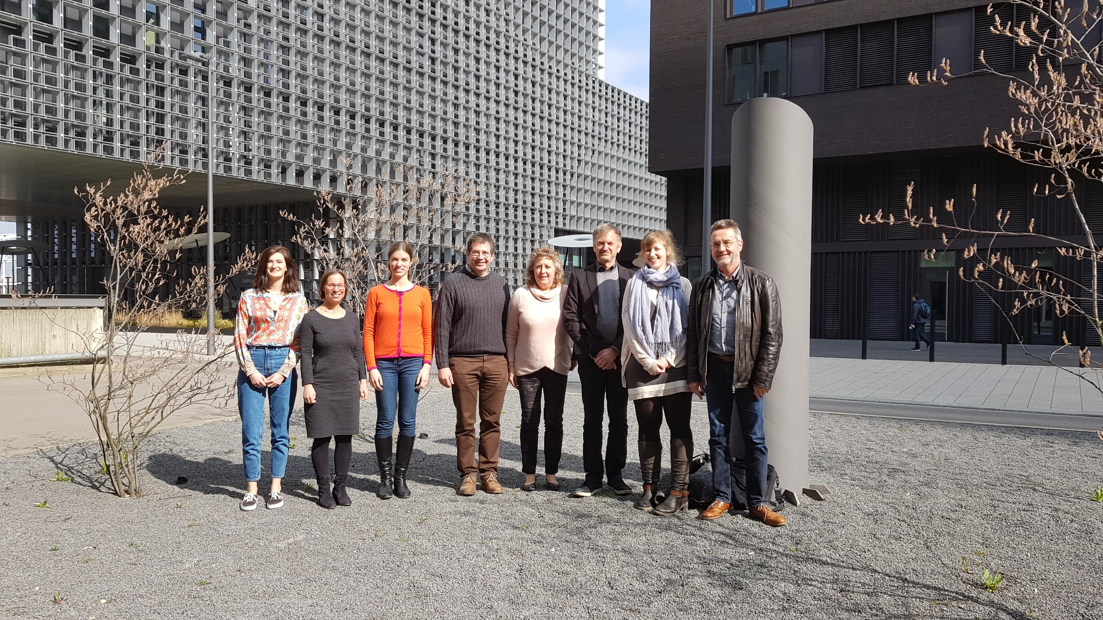
Staff Musicology Uni Lëtzebuerg

Slide 27
Muito obrigado pela atenção
Merci fir Äert Nolauschteren
Благодарю вас за внимание
Danke für Ihre Aufmerksamkeit
Grazie per l'attenzione
Merci pour votre attention
Köszönöm a figyelmet
Damien Sagrillo, Université du Luxembourg
Thank you for your attention
Muchas gracias por su atención

Slide 28
L’enseignement musical (EM) comme discipline scolaire et ses approches thématiques
Musikwissen
  Musikinstrumente
  …
Musikhören
  Malen auf Musik
  Schreiben zu Musik
Musik machen
  Rhythmus (Rhythmuslieder,…)
  Bewegung und Tanz
  Singen (Schulmusikbücher, Karaoke)
  Musik mit Instrumenten
Créativité musicale
Ces multiples approches, un problème* ou une issue?
Musikaktivitäten
Musikwissen
  Musikinstrumente
  Amadeus
Musikhören
  Malen auf Musik
  Geräuschememory
  Schreiben zu Musik
Musik fächerübergreifend
  Haiku vertonen
  Schreiben zu Musik
  Malen auf Musik
Musik machen
  Rhythmus (Rhythmuslieder,…)
  Bewegung und Tanz – Kreativ im Takt (KiT)
  Singen (Schulmusikbücher, Karaoke)
  Musik mit Instrumenten
Musikalische Kreativität
  Musik komponieren
  Kreativ im Takt (KiT)
Notes:
*Beaucoup ne prennent la branche musique pas au sérieux. Et, hélas, la réalité leur donne souvent raison. Nous refusons aux enfants et aux adolescents des succès d’apprentissages musicales, en les sollicitant de façon paradoxale insuffisamment par une pléthore thématique
(Jank / Stroh)

