Slide 2
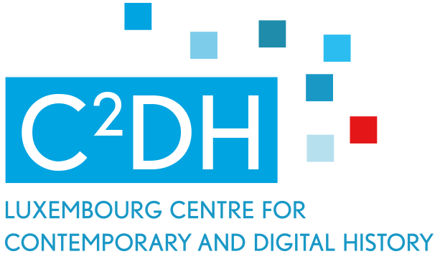
Transmission of collective memory and Jewish identity in postwar Jewish generations through war souvenirs

Slide 3
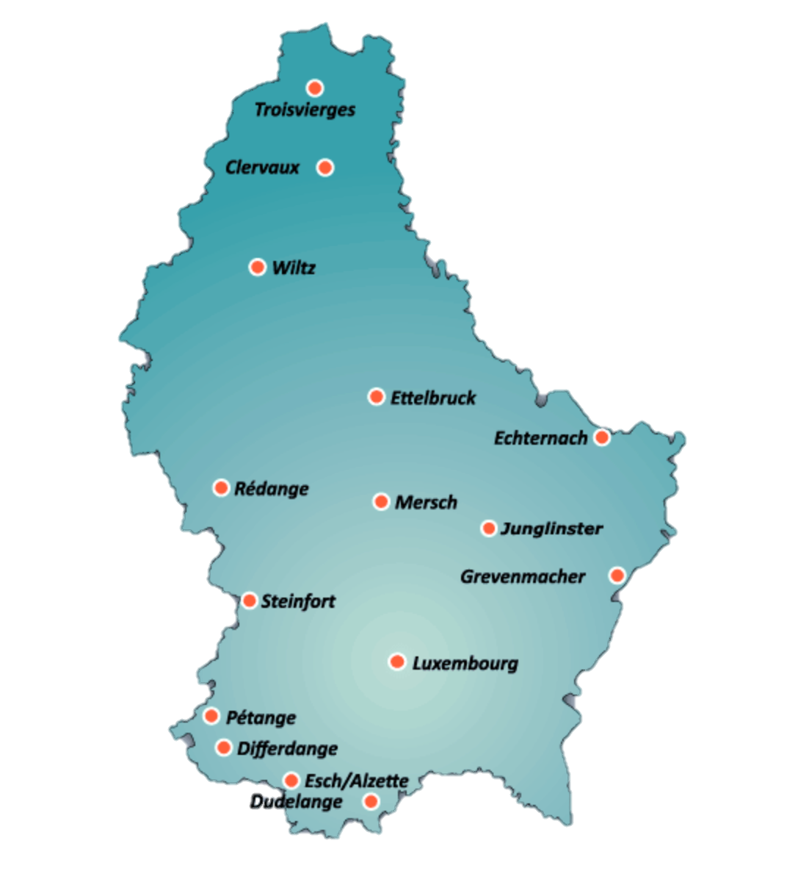
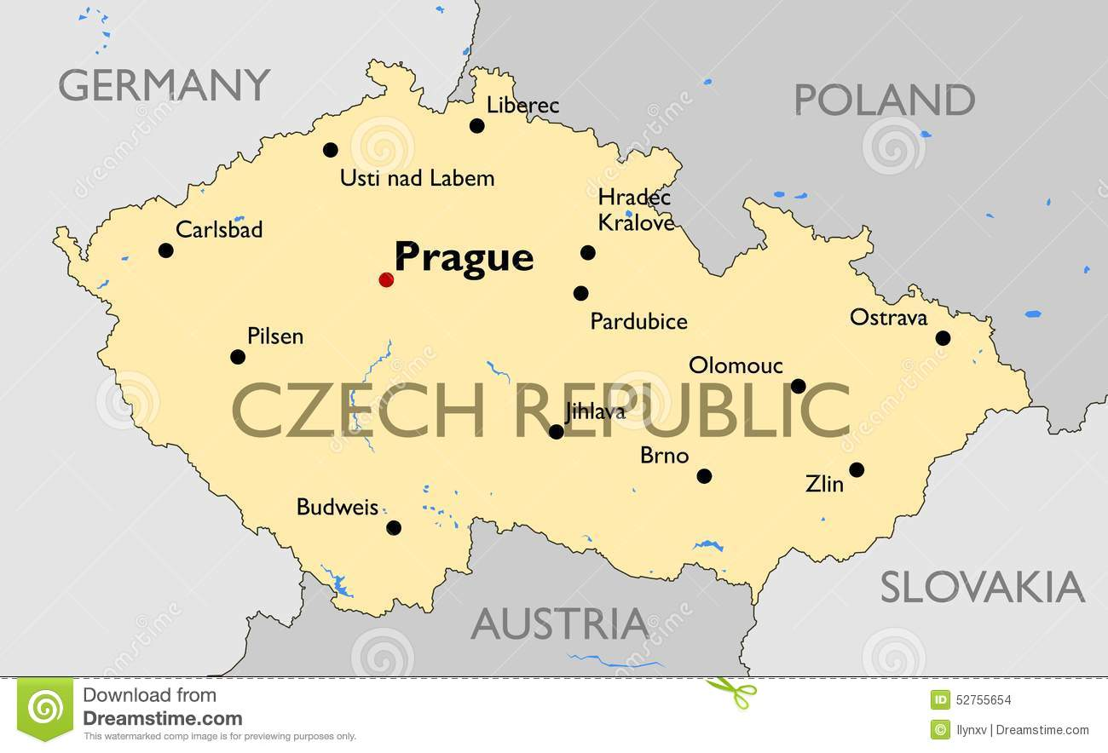

Slide 4
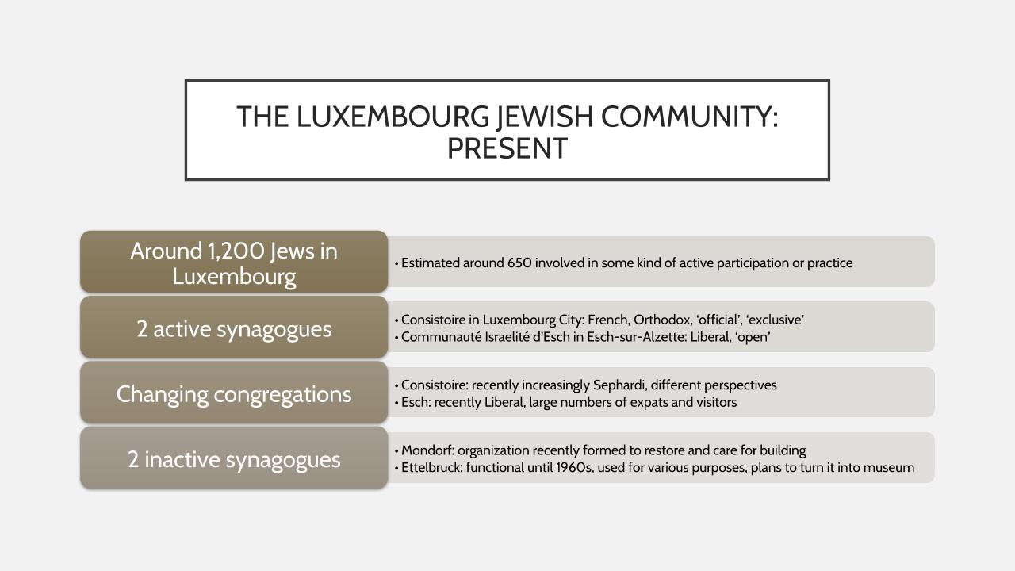

Slide 5
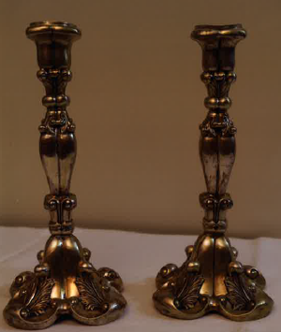
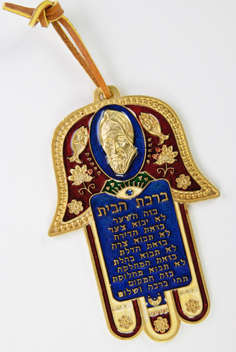
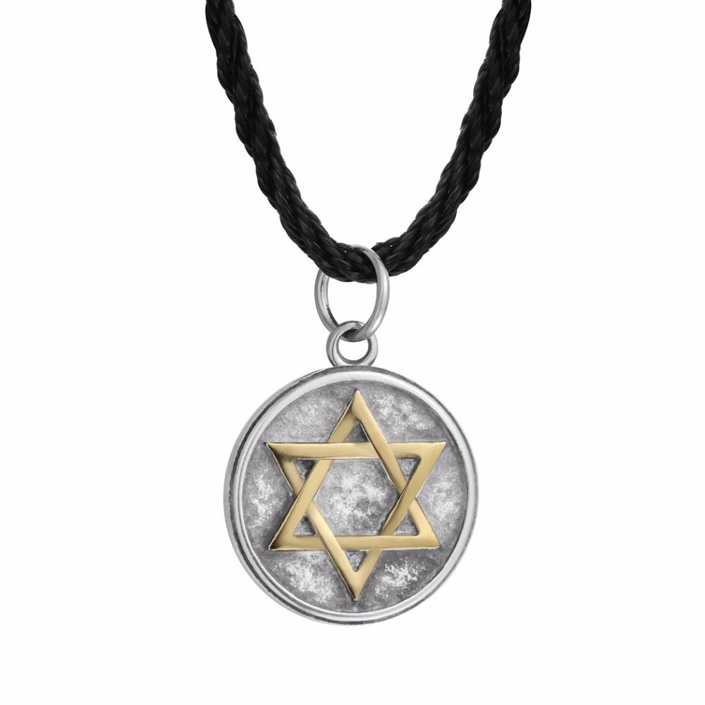
Allegations:
Younger Jewish generations loses its cohesion and identity and they do not care much about family heirlooms.
Young Jews regard Jewish ritual/religious objects only as amulets.

Slide 6
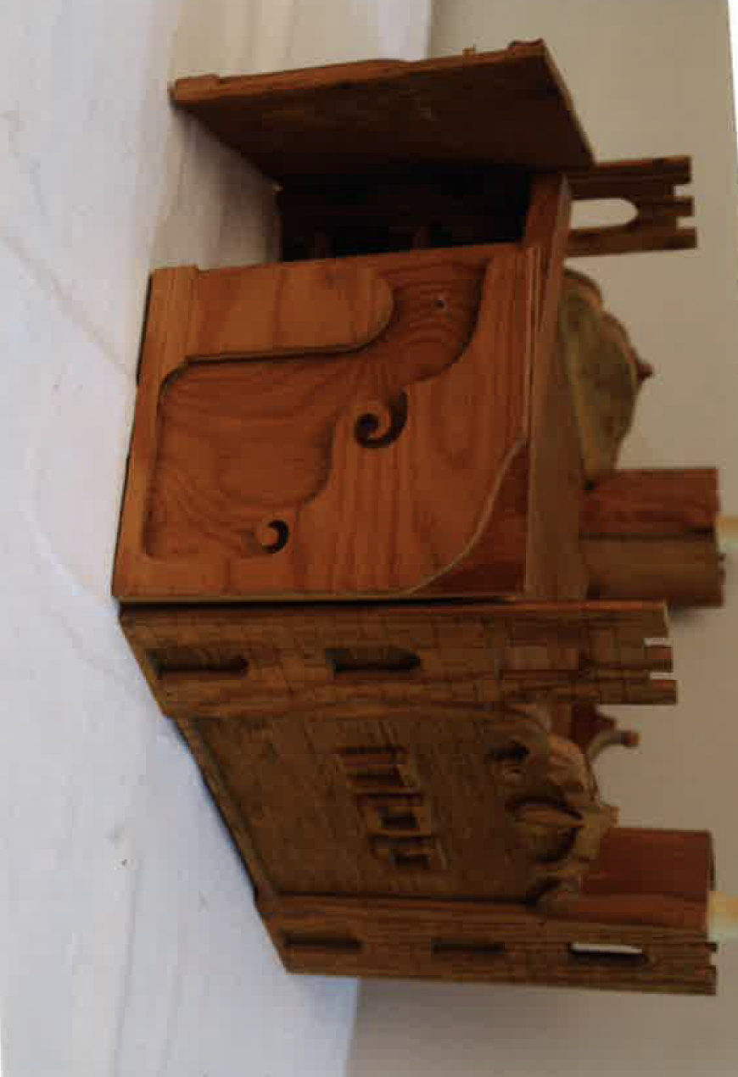
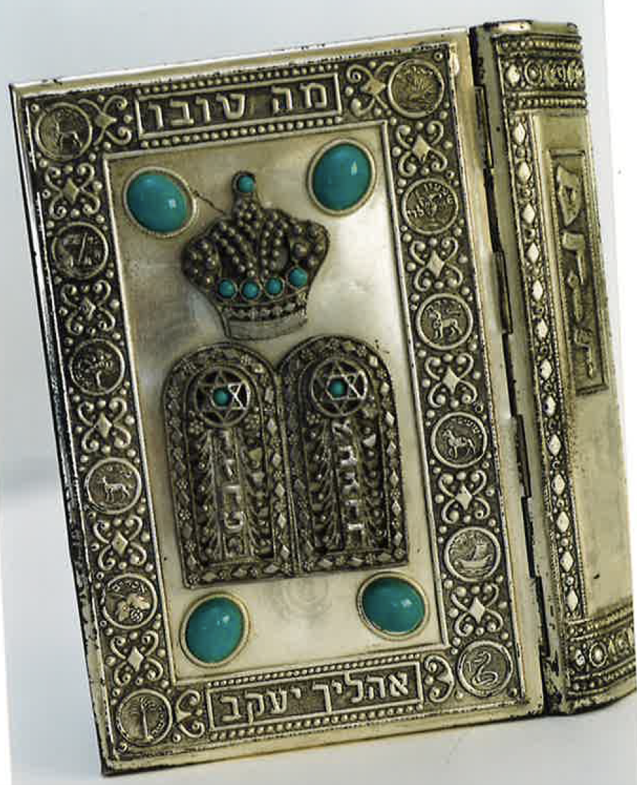
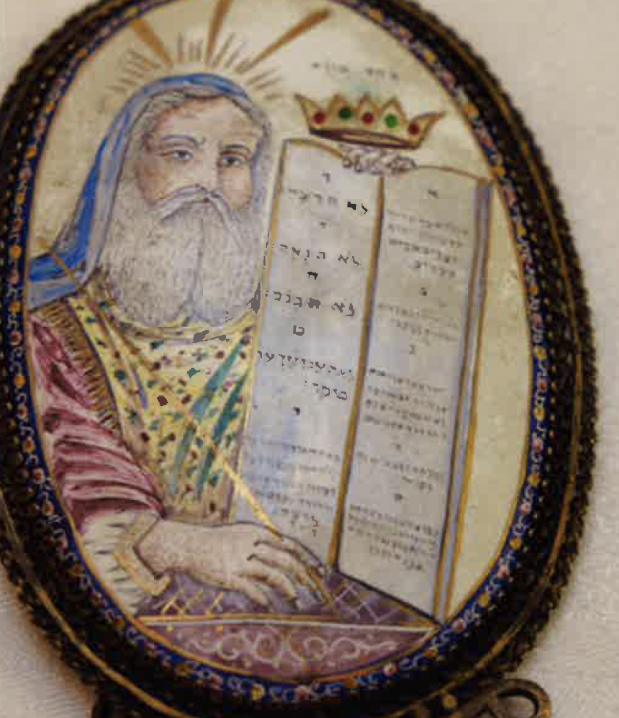
Introduction:
40 testimonies containing the life stories of Jews born in the aftermath of World War II in two countries (Czechoslovakia and Luxembourg)
The importance of small artefacts for the transmission of Jewish collective memory.
Interactive space in which objects (sacred relics, souvenirs, mementos and locks of hair) maintain a physical continuity of resemblance.

Slide 7
Methodology:
The questionnaire used consists of 32 questions, 3 of which are dedicated to family heirlooms and ritual objects.
Respondents are classified into categories according to their generation and place of living
Respondents were given instructions to supplement each answer by lengthier comments about family artefacts.
1) How important are family memories for you (photographs, letters, genealogy, ritual items, etc.)?
2) What is your children' relationship to family heirlooms?
3) Do you wear any visible Jewish symbols or symbols associated with the Middle East (rings, key rings, bracelets, etc.)?

Slide 8
Graphic 1
How important are family memories for you (photographs, letters, genealogy, ritual items, etc.)?

Slide 9
Graphic 2
Do you wear any visible Jewish symbols or symbols associated with the Middle East (rings, key rings, bracelets, etc.)?

Slide 10
Graphic 3
Perception of selected Jewish objects in second and third generation Jews (LUX+CZ)

Slide 11
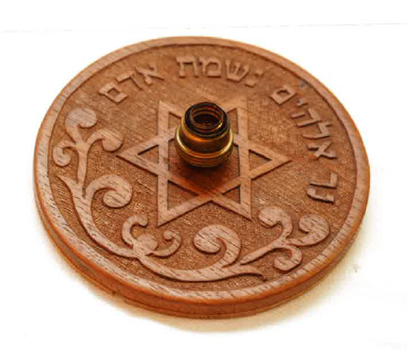
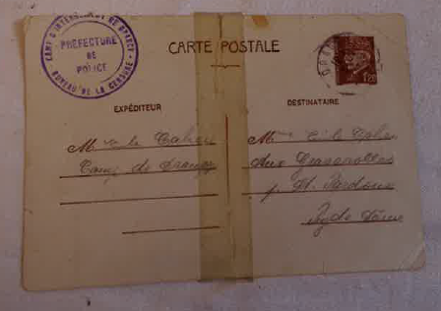
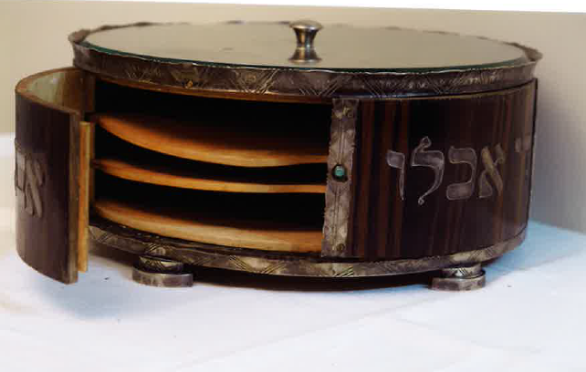
In Czechoslovakia, a large number of parents failed to keep religious precepts alive.
Guarded family artefacts help to retain childhood memories of their ancestors.

Slide 12
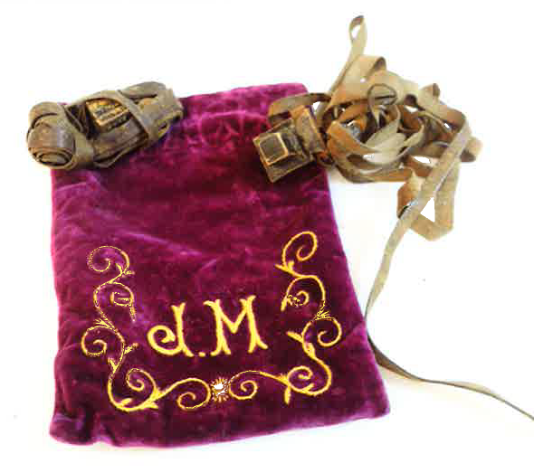
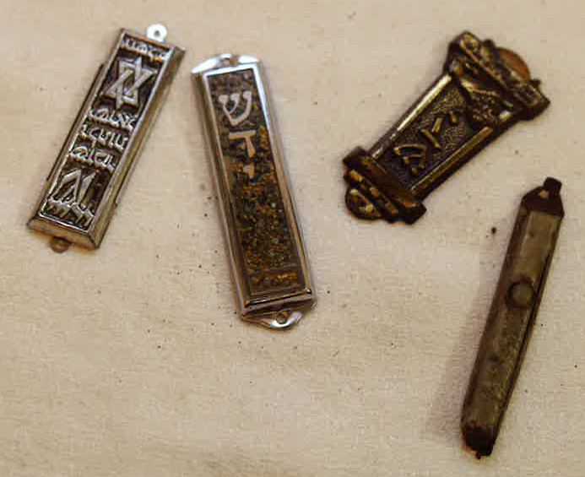
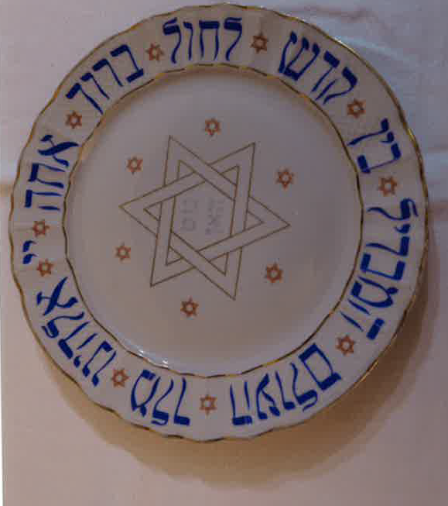
Jewish ritual items
For Luxembourgish Jews this kind of object is converted into a lieu de mémoire and placed into a broader context.
Members of the third generation do not miss the tactile contact with objects belonging to their ancestors, unlike their parents.
Young men and women in both Luxembourg and the Czech Republic often wear accessories – rings, necklaces, earrings or bracelets.

Slide 13
Jewish ritual items
The second generation is more attached to ritual artefacts belonging to their ancestors (who died in the Holocaust).
The third generation is interested in ritual and religious items in a more complex, less emotional and contextualized way.
The relationship with a family ritual heirloom passed on in a legitimate way is often forme gradually and imperceptibly.
The second generation is also more suspicious of the origin of valuable items.

Slide 14
Jewish relatives in old photographs
Parents were missing from their collection since they refused to be photographed in later life unless strictly necessary.
Some consider family photos as sacred objects that should not be exposed via online social platforms.
Narrators cherished a faded and shabby photo that vividly reflected its former owners more than a photo that did not bear the scars of time.
Even though the narrator had several ancient Jewish objects in her home, she considered them to be less interesting since she used them for everyday purposes and associated them with the contemporary cultural system.
In some cases photos became a part of another object (e.g. a cigarette case with a miniature on its cover or a pocket watch).

Slide 15
Jewish identity and material culture
Jewish identities are not exclusive, but they are naturally multidimensional and constitute one of the components of a person’s overall identity. (Tartakowsky and Dimentstein 2017)
Material artefacts consolidate a fundamentally social identity and indicate conformity with a particular society. (Wasserstein 1996)
Ex.: Interview with a Czech woman Michaela V.
Ex.: An interviewee from the third generation considered her mezuzah to be her most valuable family heirloom.

Slide 16
Jewish virtual gateway
Interactive, dynamic and inspirational virtual library based on the interface of various international projects (e.g. Sephardi voices, Jewish virtual library and Yiddish sources.
Timeline – composed of crucial milestones in Jewish modern history in Luxembourg and Czechoslovakia.
Visualised datasets of questionnaires together with a basic description.
Thematically classified external links
Photo gallery of exposed artefacts
Regional stories based on personal narratives.

Slide 17
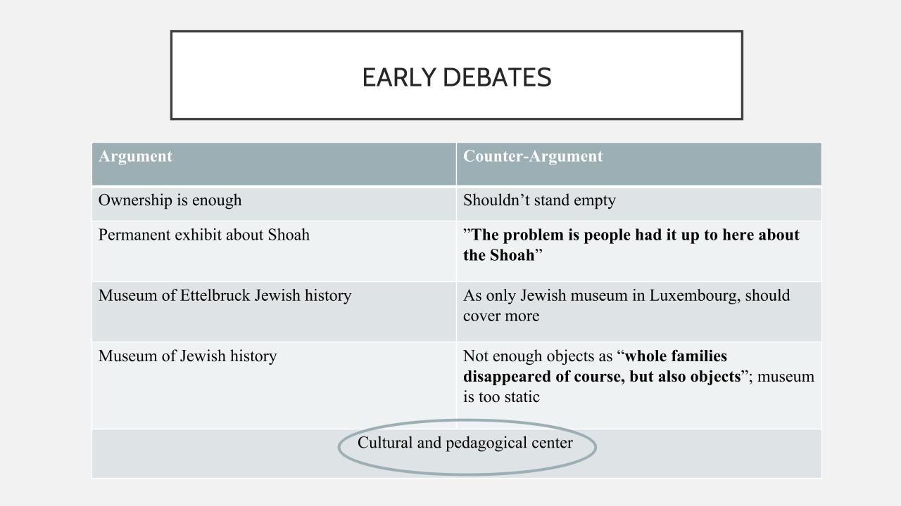

Slide 18
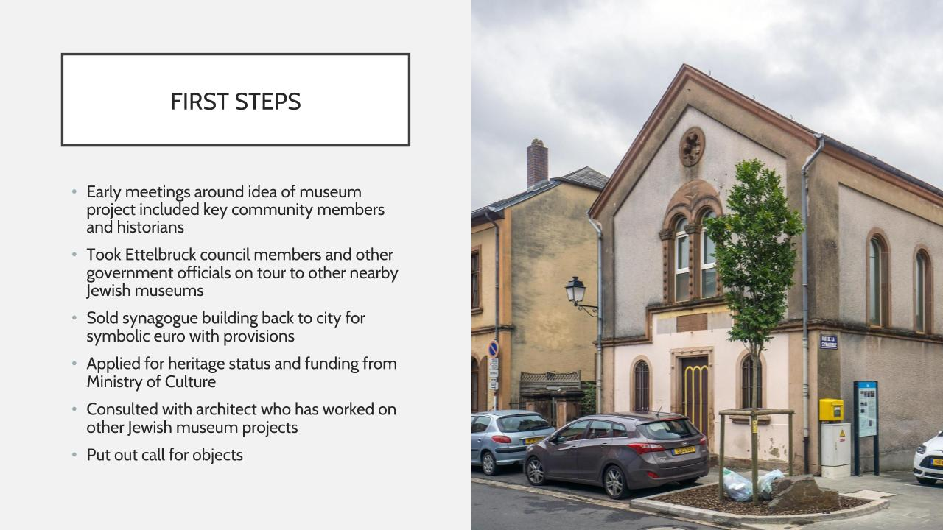

Slide 19
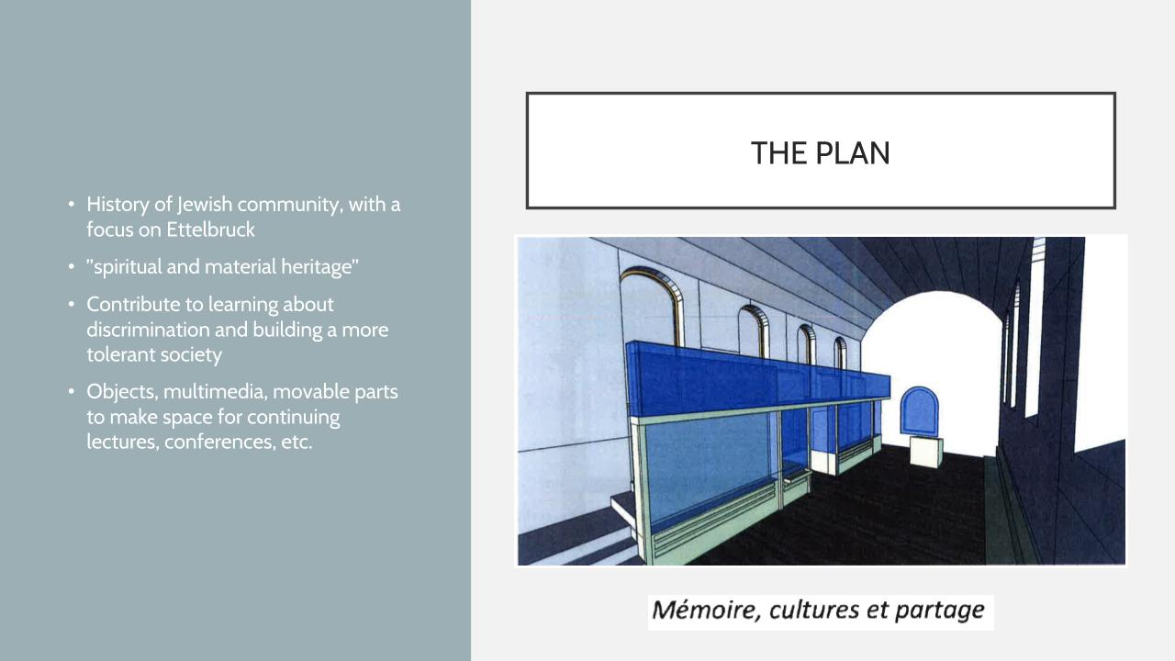

Slide 20
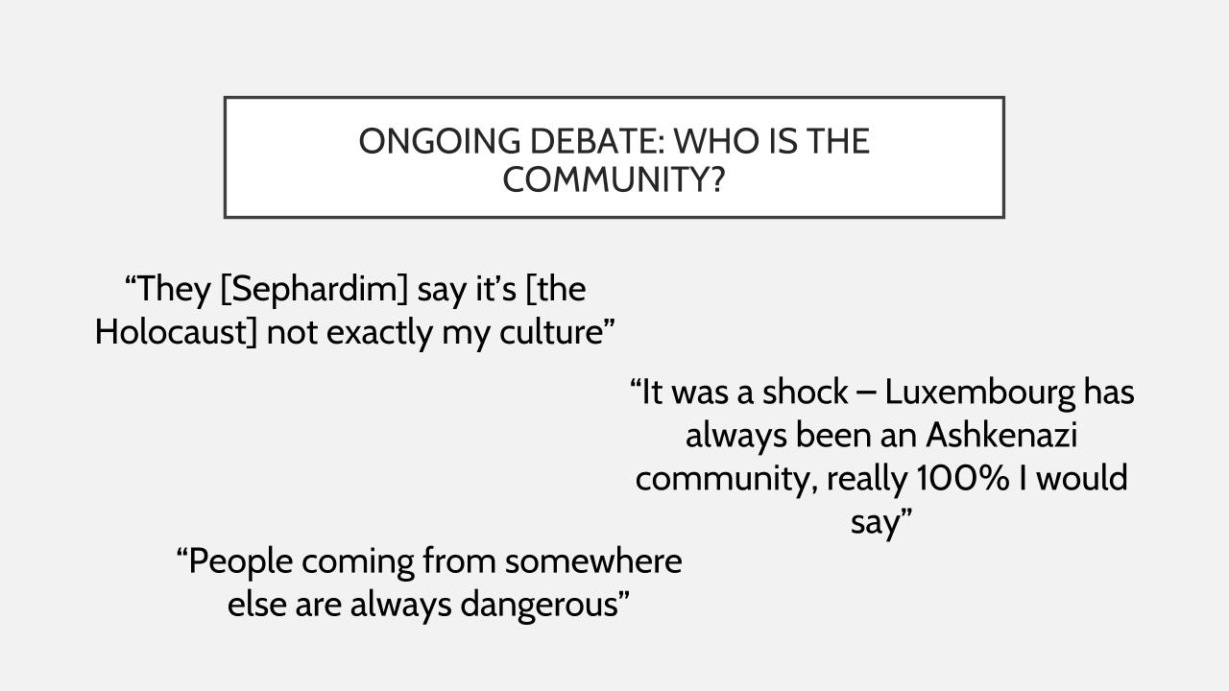

Slide 21
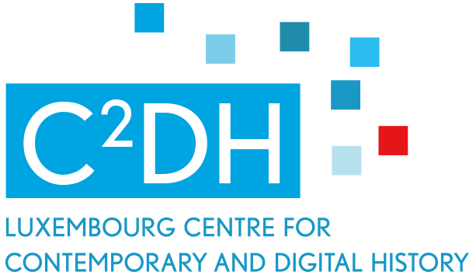


Thank you very much for your attention
@C2DH_LU
https://www.facebook.com/c2dh.lu/
www.c2dh.uni.lu

