Slide 1



Mapping mobility – pathways, institutions and structural effects of youth mobility in Europe
MOVE Results
Volha Vysotskaya
University of Luxembourg
29th General Assembly of ERYICA
Cascais, Portugal
26 April 2018
The research from the MOVE project leading to these results has received funding from Horizon 2020 under Grant Agreement N° 649263.

Slide 2

Outline of the presentation
Presentation of the MOVE project
MOVE results
  Cluster analysis and country typology
  Patterns of Mobility
  Motivations and fostering factors for mobility
  Obstacles for mobility
  Financement of mobility
  Gender aspect
At a closer look
  Social relations dimension
  Learning dimension
  Individual development dimension
  Organisational membership dimension
  Socioeconomic and opportunity structure dimension
  Overlapping mobility
Mobility types dilemma

Slide 3
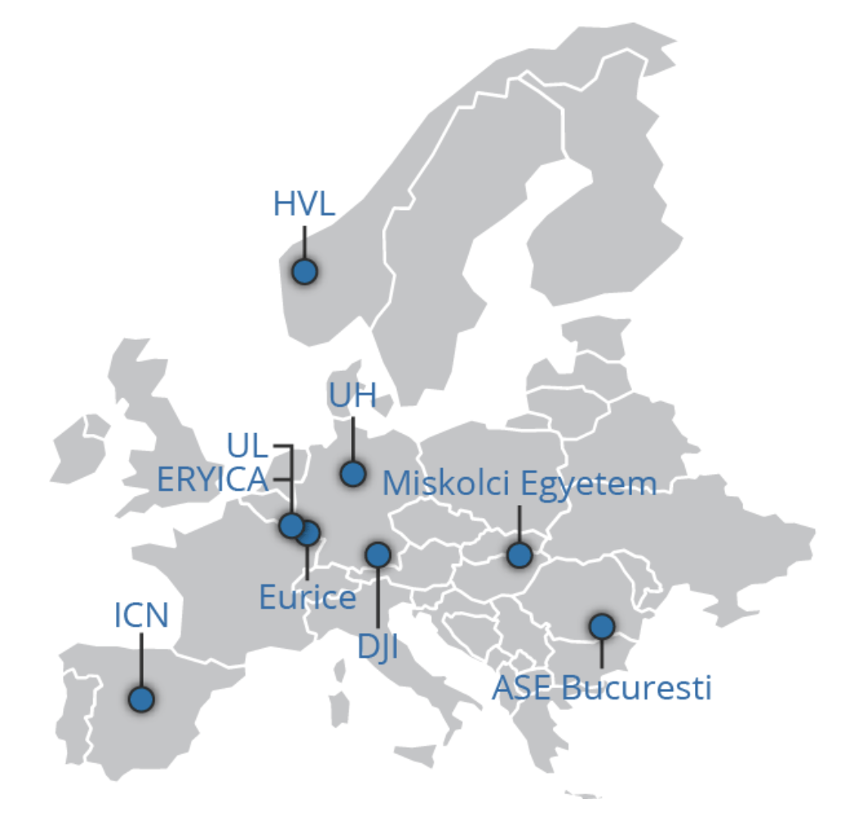
MOVE in a nutshell
EU H2020 Project
Call: Young-2-2014-Youth mobility. Opportunities, impacts, policies
Duration: 01 May 2015 - 30 April 2018 (36 months)
Beneficiaries:
N° | Participant organisation name | Country
1 | Université du Luxembourg (UL) - Coordinator | LU
2 | Universität Hildesheim (UH) | DE
3 | Deutsches Jugendinstitut e.V. (DJI) | DE
4 | Academia De Studii Economice Din Bucuresti (ASE Bucuresti) | RO
5 | Miskolci Egyetem | HU
6 | Western Norway University of Applied Sciences, Høgskulen på Vestlandet, Norway | NO
7 | Ilustre Colegio Nacional de Doctores y Licenciados en Ciencias Políticas y Sociología (ICN) | ES
8 | European Research and Project Office GmbH (Eurice) | DE
9 | European Youth Information and Counselling Agency (ERYICA) | LU

Slide 4
Research question & Main objectives
  How can the mobility of young people be “good” both for socio-economic development and for individual development of young people, and what are the factors that foster/hinder such beneficial mobility?
Carry out a comprehensive analysis of the phenomenon of the mobility of young people in the EU
Generate systematic data about young people’s mobility patterns in Europe based on case studies, a mobility survey and secondary analysis
Provide a qualitative integrated database on European youth mobility
Offer a data-based theoretical framework in which mobility can be reflected, thus contributing to scientific and political debates
Explore factors that foster and hinder mobility (based on an integrative approach, with qualitative and quantitative evidence)
Provide evidence-based knowledge and recommendations for policymakers through the development of good-practice models to:
          a. Make research-informed recommendations for interventions to facilitate and improve the institutions, legal and programmatic frames with regard to different forms and types of mobility as well as to the conditions/constrains of mobility for young people in Europe
          b. Give consultation and expertise to those countries facing significant challenges related to geographical mobility of young workers

Slide 5
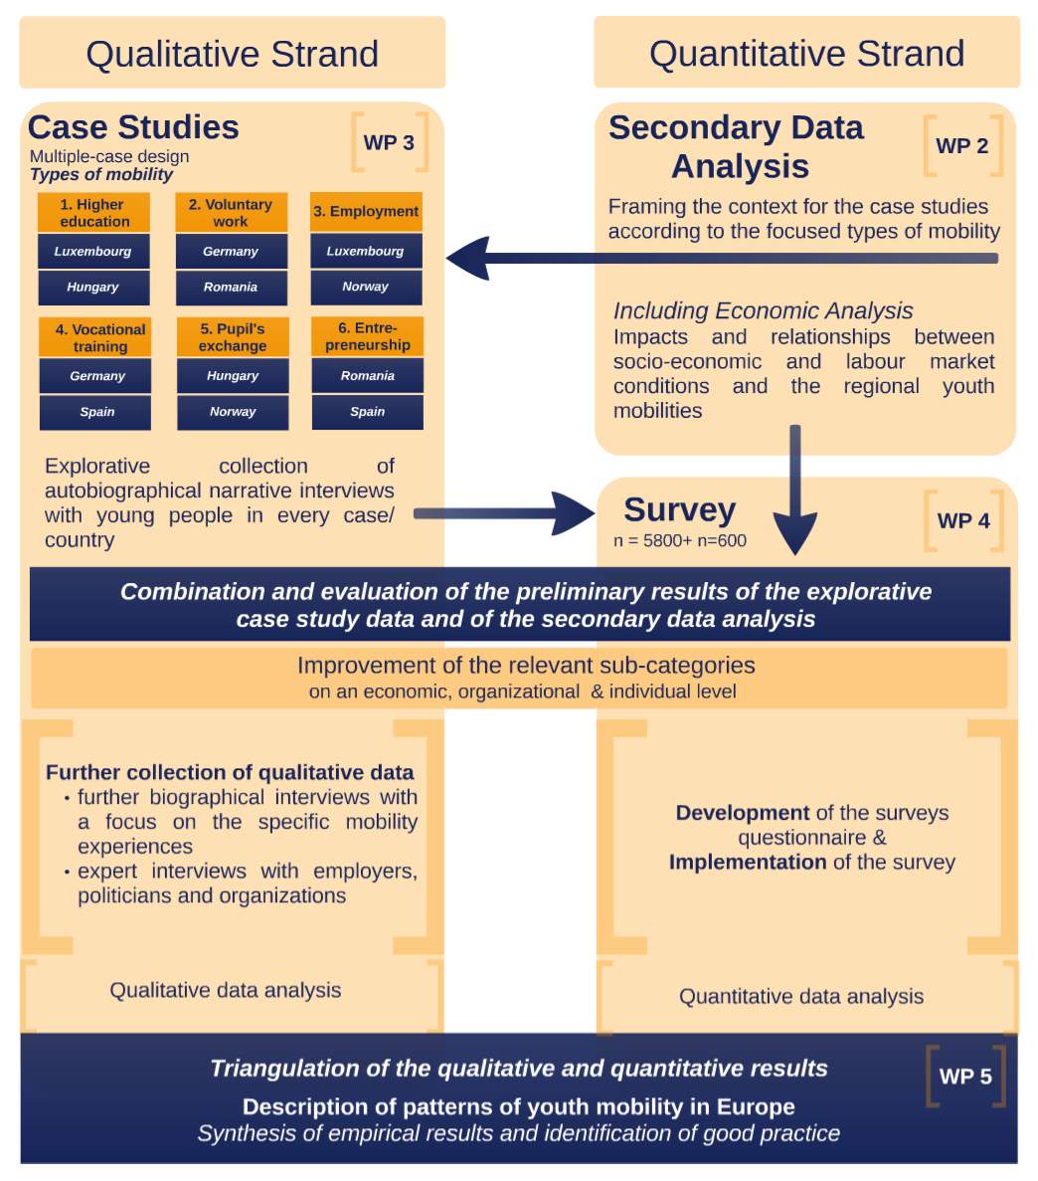
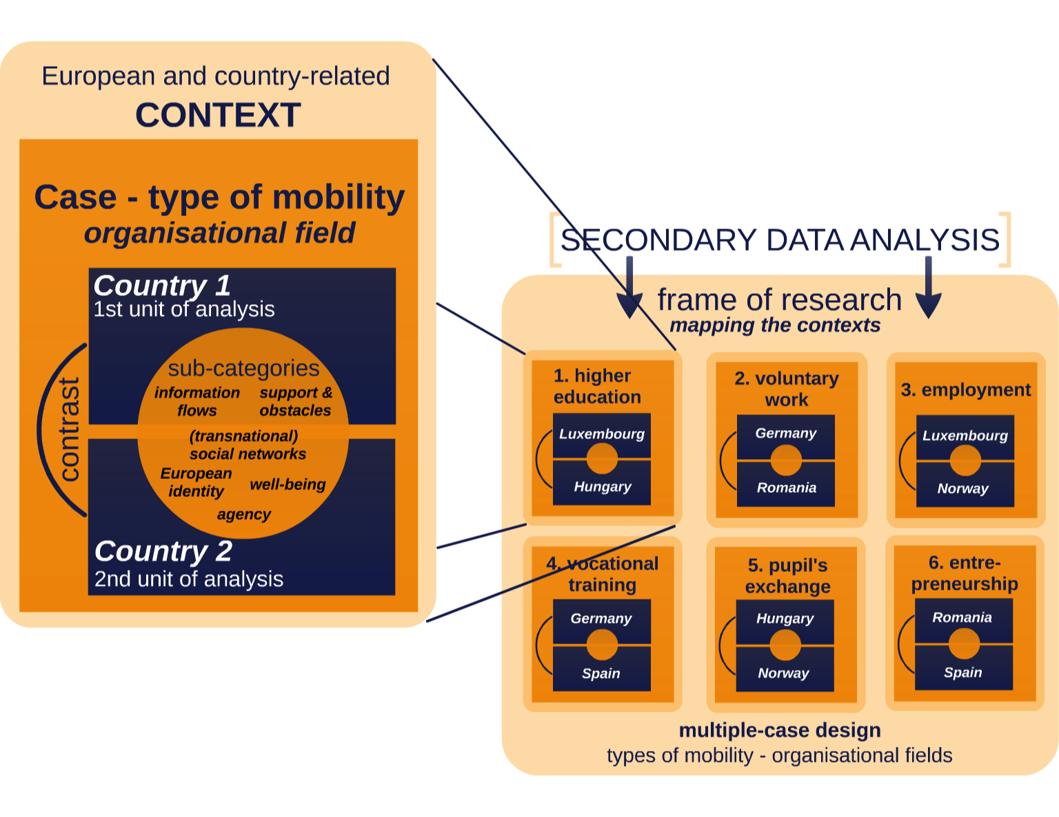
Research design Case studies

Slide 6

Quantitative strand I: Secondary data analysis
Objective: to explain mobility patterns, circumstances of mobility and migration and the connection between different forms of mobility
  Databases: EUROSTAT and national surveys on youth mobility, etc.
  Macro-Data inventory and Scientific Use Files for Youth Mobility
  Conducting comparative cross-sectional and time-series descriptions
  Developing background models for youth mobility
  Synthesising research results schemes
  Exploring the intensity of the relations between youth mobility and social and economic conditions in the five countries
  Describing and assessing the potential influence of youth mobility on national labour markets from a macro-economic and demographic perspective
Notes:
SUF The MOVE-SUF was set up with data for all EU-28 and 3 EFTA countries (Switzerland, Iceland and Norway) from 2004 until 2013

Slide 7
Qualitative Strand II: Case studies
Objective: to provide explanations and insights into specific contexts of mobility
Semi-structured interviews with young people
Total: 206 with young people
  Expert interviews with employers, representatives of organisations framing one type of mobility, representatives of the administrations who are responsible for recognising credentials and certificates, Chamber representatives
  Total: 36 with experts

Slide 8
Quantitative strand III: Online survey
Objective: obtain quantitative data about European young people’s experience and perceptions of mobility, and to compare the analysed countries in the EU to identify general patterns and regional clusters of young peoples’ mobility.
Total: 8,706 mobile and non-mobile youth
Languages: 10 - German, French, Romanian, Spanish, Norwegian, Hungarian, English, Luxembourgish, Nynorsk, Bokmal
Online survey (n=5,499)
Germany 961
Hungary 980
Luxembourg 739
Norway 877
Romania 976
Spain 966
Snowball sampling (n=3,207)
Germany 1,124
Hungary 157
Luxembourg 231
Norway 176
Romania 354
Spain 1,165

Slide 9
MOVE results: Cluster analysis
The country analyses revealed two main clusters:
1) centre-receiving countries and
2) periphery-sending countries
plus Luxembourg and Norway in a third cluster as outliers.
Finding 1: Only some European countries benefit from long-term incoming mobility; others lose human capital, especially when highly-qualified youth move abroad.
Finding 2: National economies profit from returning young people who gained competences abroad.

Slide 10
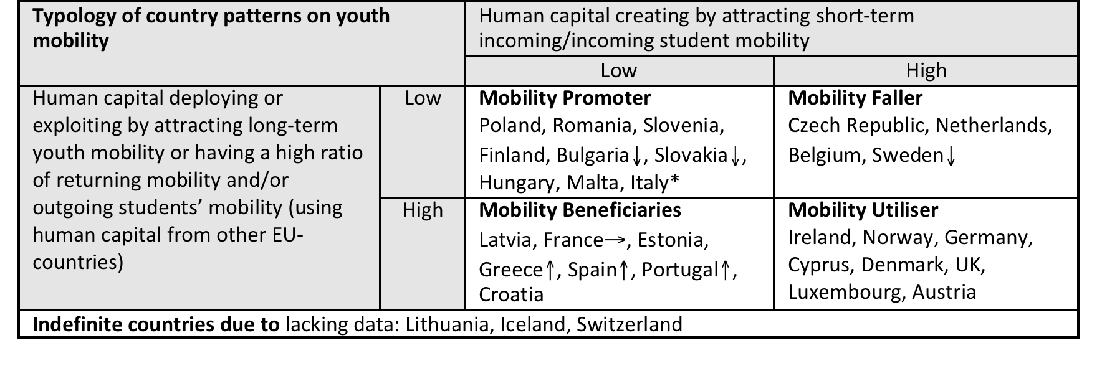
MOVE results: Country typology
The country typology:
1) mobility promoters (HU, RO)
2) mobility fallers
3) mobility beneficiaries (ES)
4) mobility utilisers (DE, LU, NO)

Slide 11
MOVE results: Patterns of mobility I
Yes and there was also a friend, who had already studied [there]. She was already there and I lived with her, she was also Luxemburgish. By the way, I wouldn’t FOR SURE go alone to [town A, Belgium] (Higher education student mobility, Luxembourgish sample, N5)
1. Peers as mobility incubators
In terms of school, I felt that I had really learned in Romania and this gave me trust in myself and trust in Romania, but on the other hand I realised that what you learn in another country is not only in school, but also the cultural side, which is much more important… and you see so many different points of view and that is why I said I want to spend some more time here, at least to learn more, to get to know these different cultures, to see what this is all about. (Entrepreneurship mobility, Romanian sample, N3)
2. Learning something through mobility
The classrooms are so outdated I can’t imagine how the seminars take place… There was a lot of theoretical curriculum. The situation in Germany is the opposite. There were more seminars than theoretical knowledge. I learnt things that were not down-to-earth and I won’t use in life. There were no projectors, technical tools were not available in every classroom. Classrooms were not well-equipped. Where I was, there were multifunctional projectors, air-conditioning, drapers – everything was provided, you just had to grab your USB, we also had Internet access, which was essential (Higher education student mobility, Hungarian sample, N19 )
3. Institutionalised work and education

Slide 12
MOVE results: Patterns of mobility II
And you had said that he actually wanted to go out without an organisation but then he had to [find one]. How come? Y: I don‘t know the details. But like it‘s about insurance and finances and such things. But they were organisational things, which would have become much much more complicated if you had done it without a supporting organisation (Voluntary work mobility, German sample, N3)
4. Organisational membership
I actually did not expect to survive that long alone, but so far, I am doing well, I am alive, I did not lose weight so it is nice (laughter) yes so far I think I will stay. I moved. I emancipated 3,000 kilometres from my parents’ place. It is quite a big job. It makes me proud of myself; I actually could achieve that on my own. Therefore, for me it was a big experiment, I wanted to do that, I could do it, I did, and I have succeeded at some point (Employment mobility, Norwegian sample, N14 )
5. Wish to become independent and to “go out”
So for me it was the first time, that I really was separated by my family, (.) and my parents didn’t really get along with that at the beginning. So they/ they/ they wanted to / they wanted a lot, umm, hear, more or less. (.) So / we agreed on: okay, talking on the phone once a week, Skyping or something like that. And that was even too much for me. I just really wanted to be there. I wanted to concentrate myself on being there and not have that much connection to home (Voluntary work mobility, German sample, N3 )
6. Leaving home with the wish to “break out”

Slide 13
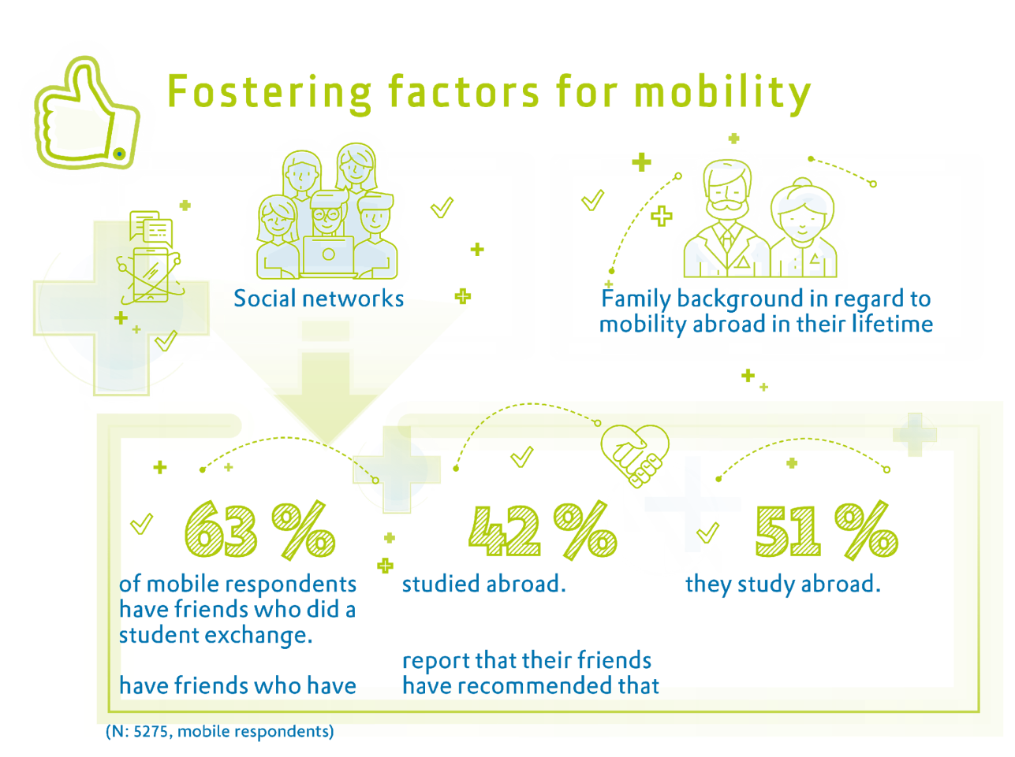
MOVE results: Motivations and fostering factors for mobility
Motivations for Mobility (mobile/non mobile) | Freq | % total
To learn/improve languages | 882 | 46.3
Previous knowledge of the language (convenience) | 633 | 33.0
In order to improve opportunities for personal/professional development | 493 | 31.2

Slide 14
MOVE results: Obstacles for mobility

Slide 15
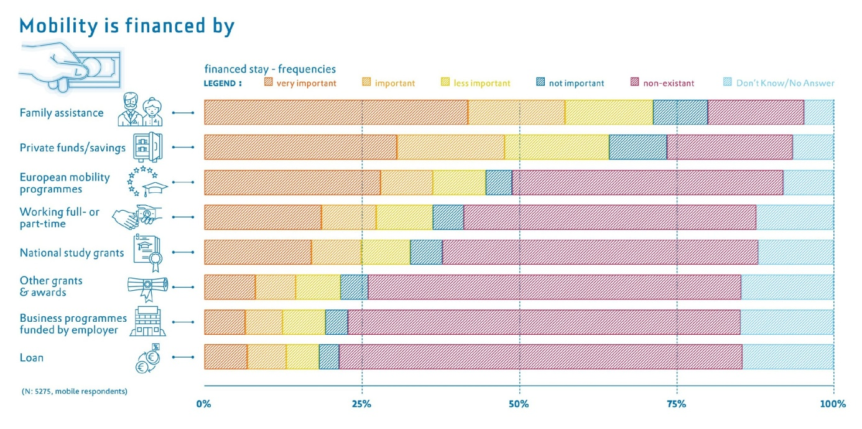
MOVE results: Mobility is financed by:

Slide 16
MOVE results: Gender aspect
  Being a male increases the probability of being mobile for study reasons by 20.2 percent (Scandinavia is the opposite)
  Males with tertiary education (if unemployed) less work-related mobility, females with tertiary education (if unemployed) more work-related mobility
  Organisations: women maintain larger informal networks whilst men take part in formal organisations, such as associations etc.
  Lower education levels decrease the probability of mobility by studies, 49.8 and 37.4 percent, respectively.
Notes:
Our first finding does not match the previous literature, but we have found it within our surveys. (male and female going outside for study reasons)
Males with tertiary education move less (in line with previous literature)
Women have less formal membership to associations, what does this mean? We should suggest further research on this in terms of policy implications.
Lower education levels decrease the probability of mobility studies (so educational background of the young person is very important)

Slide 17
MOVE results at a closer look : Social relations dimension
  Peers as mobility incubators
    stronger role for educational mobilities (35.3%)
    less influential for work-related mobility (30%)
  Peer networks are regarded as useful sources of information on mobility.
    (35.7%) of young people rely on the mobility-related information provided by friends as well as by social media, which are also among popular channels for identifying information (25.7%).
  Peers are especially friends with mobility experience
    63.2% of mobile respondents have friends who did a student exchange
    42.4% have friends who have studied abroad
    51.4% report that their friends have recommended them to study abroad.
Notes:
Peers as mobility incubators are one of the central mobility patterns that have been identified in the qualitative analysis and show how everyday social relationships and organisations can enable youth mobility. Peer relationships are, in fact, the main context within which youth mobility is bred, induced or hampered. Friends play a significant role in the mobility of young people. Moreover, survey results show that friends play a slightly stronger role for educational mobilities (35.3%) and are less influential for work-related mobility (30%). Furthermore, peer networks are regarded as useful sources of information on mobility. A large number of young people rely on the mobility-related information provided by friends (35.7%) as well as by social media, which are also among popular channels for identifying information (25.7%).
As such, mobility does not occur spontaneously in a vacuum, but is rather rooted (embedded) in social networks. To mobile young people, peers are especially friends with mobility experience; likewise, peers are also other people (i.e. relatives, siblings, acquaintances) with previous or current mobility experience. This can also be found in the results from the quantitative survey that shows that, especially for young people in long-distance mobility, 63.2% of mobile respondents have friends who did a student exchange, 42.4% have friends who have studied abroad, and 51.4% report that their friends have recommended them to study abroad. Furthermore, peers are also influential in the decision-making process: they are of a central importance not only in generating mobility plans but also in providing an accompanying community and in creating a new form of belonging. Thus, peers are presented as a central resource in the actual process of mobility, allowing young people not only to tackle mobility but also to maintain existing forms of social belonging and create new ones as well as to enter into a dialogue with other peers.

Slide 18
MOVE results at a closer look: Learning dimension
  Mobility as a “huge opportunity” for young people to improve education stronger role for education, especially language
  English is important for mobility
  BUT
  Language is also the MAIN barrier to mobility
    32.4% emphasised a lack of sufficient language skills as a barrier to their mobility
    Language is also the most important barrier amongst non-mobiles (42.7%).
Notes:
Young people’s learning processes are closely interwoven with mobility. The preparatory stage in itself is already interpreted as a learning process. Mobility is seen, among other things, as a “huge opportunity” for young people to improve their education. Here, learning a language tops the list. Young people incorporate the language into mobility; they become mobile with the motivation to improve existing language skills or to learn a new language. Learning language is regarded as the most important motivation affecting mobility in almost half of the respondents of the survey. Furthermore, learning and improving English language skills is of a particular importance for all types of mobility; young people link English with future studies and employment opportunities. Following this objective via different mobilities, young people move to English-speaking countries and practice English as a lingua franca in international, globalised destinations.
At the same time, language is also the main barrier to any mobility type: over one third of mobile survey participants (32.4%) emphasised a lack of sufficient language skills as a barrier to their mobility, which is also found to be the most important barrier amongst non-mobiles (42.7%).

Slide 19
MOVE results at a closer look: Individual development dimension
  Mobility is important during youth, it is one of the youth practices
    to become independent ,“go out” and become autonomous
    to find new ways of positioning themselves in social relationships in the new destinations
  Even in employment and entrepreneurial mobility: young people learn
    improving working conditions (31.2%)
    improving opportunities for personal and professional development (28.7%)
Notes:
As young people account having learned many things, mobility is thus presented as a context in which numerous kinds of learning take place in various ways and can lead to not only language learning, but also new self-positionings, independence, and adaption to organisations. In this way, young mobile people connect their mobility to their wish to become independent and to “go out”. These ambitions can be framed as a specific set of youth practices. Mobility is seen as a process of becoming independent, as a chance to learn to get by and make their own way outside the framework of the family. Characteristically, this is also placed in the context of their learning history as young people. The learning effect is particularly obvious with regard to the young people themselves and their own achievements and realisations. The data shows that these practices are contextualised by most young people as relevant to their age group. The qualitative analyses provide examples of “doing youth” by individual coping strategies and by working through bureaucratic challenges. The mobility also allows young people to discover aspects of their personalities, providing a strong impetus for development in both their professional and personal lives. Qualitative data confirms that mobility is understood as a process that helps unveil new perspectives and create forms of social belonging, self-positioning and independence-seeking, all of which fall outside the realm of the familiar. Young people also emphasise the opportunities that mobility gives them to find new ways of positioning themselves in social relationships in the new destinations. All in all, mobility is presented as a context in which learning is not only possible but quite necessary. The young people do as is implicitly societally expected of them as youth: they learn something. This learning process and the possibility of “doing something else” (e.g. instead of learning in formal, institutional contexts such as schools and universities) are seen as legitimising mobility. Mobility itself is not sufficient to be called youth mobility and needs to be enriched by additional activities and processes - of learning – to be youth mobility.
In that way, learning through mobility is equally important to all youth mobility types, including working mobility (i.e. employment, entrepreneurship). To them mobility allows for either improving working conditions (31.2%) or improving opportunities for personal and professional development (28.7%).

Slide 20
MOVE results at a closer look: Organisational membership dimension
    Organisation of mobility is a challenging process for young people
    Young people rely on own, more informal sources of information and use personal sources
      Internet search engines (48.5%)
      friends (35.7%), and teacher recommendations (32.1%)
      Online communities/social networks and university websites (over 25%)
        In education mobility young people rely - more on informal sources, i.e. teachers’ advice and search engines than less on formal channels,
        in employment mobility young people do not rely on any formal channels: very few (over 1%) mention EURES, followed by specialising portals, employment agencies, and government websites.
Notes:
The preparation and organisation of mobility are both regarded as a challenging process for young people. The hypothesis is that people are more easily mobile when they are members of a certain organisation. In order to become mobile, young people must become a member with regard to the organisation – not necessarily in the literal sense, but in the sense that they must be assigned a certain membership role, be more or less formally accepted, and prove themselves. The most basic membership is reached by obtaining membership in the category which the mobility programme addresses: in the case of pupil mobility, young people’s role would be to be mobile as schoolchildren; in the case of employment mobility, their role is to be mobile workers, etc. Young people are thus always mobile as members of an organisation, and not as single individuals. Once the youth’s fit with an organisation is achieved, if they have gained certain organisational membership/role which entitles them to doing so, they then can become mobile.
Often it is through mobility that young people need to get by one’s own. Even the preparation for mobility is based on one’s own resources. According to the survey results, rather than relying on support from organisations, young people prefer their own, more informal sources of information and use personal sources, such as Internet search engines (48.5%), friends (35.7%), and teacher recommendations (32.1%). Online communities/social networks and university websites are also popular for obtaining information on mobility (over 25%). Relying on different sources of information and contacting mobility-related organisations varies across mobility types. While young people in education mobility tend to rely more on informal sources, i.e. teachers’ advice and search engines and less on formal channels, those in employment mobility do not rely on any formal channels: very few (over 1%) mention EURES, followed by specialising portals, employment agencies, and government websites.

Slide 21
MOVE results at a closer look: Socioeconomic and opportunity structure dimension
Parents have a major influence on the decision-making process for young people
  1/3 of young people (38.2%) take family’ opinion and support into consideration.
  Family support is the main source of mobility financing (46.1%) alongside private funds and savings (32.0%).
  Individual socioeconomic factors determine patterns of mobility or immobility:
    the level of education of young people and the level of education of the parents have a positive impact on mobility.
    The family background regarding mobility also has a positive impact, as does the age of the respondent.
BUT
Socioeconomic inequality is one of the major barriers to mobility.
  Significant country differences : the new North-South divide in Europe.
  Lack of financial resources (21.8%) is a strong barrier hindering people to becoming mobile. Lack of financing for mobility is even higher for non-mobiles (35.6%)
Socio economic inequality is considered as a central obstacle for mobility together with insufficient language skills.
Notes:
The significance of peer relations and family also indicates how strongly youth mobility is dependent on personal communities, and thereby on how these communities are integrated into youth mobility as a form of social background security and social, cultural and economic capital. These patterns are presupposed as personal enabling contexts for mobilities. Parents have a major influence on the decision-making process for young people, where over one third of young people (38.2%) reported taking their opinion and support into consideration. The results show that family support is the main source of mobility financing (46.1%) alongside private funds and savings (32.0%). Individual socioeconomic factors determine patterns of mobility or immobility: the level of education of young people and the level of education of the parents (taken as a proxy for socioeconomic status) have a positive impact on mobility. The family background (parents and grandparents) regarding mobility (having lived abroad in their lifetime) also has a positive impact, as does the age of the respondent.
Socioeconomic inequality hinders young people in the process of becoming mobile and is seen as one of the major barriers to mobility. Not all young people have the same good financial conditions to become mobile, they do not come from similar social classes, and, moreover, we found significant country differences in the major part of the analyses produced, which tends to be called the new North-South divide in Europe (Landesmann and Leitner, 2015). Lack of financial resources (21.8%) is therefore a strong barrier hindering people to becoming mobile. Lack of financing for mobility is even higher for non-mobiles (35.6%) and should be considered as a central obstacle for mobility together with insufficient language skills.

Slide 22
MOVE results at a closer look: Overlapping mobility
    Mobility impacts on youth future, especially first time mobility
    Mobile once– mobile again
      54.5 of young people who are currently mobile see mobility in their future
      40% with previous mobility experience see mobility in their future
    Mobilities are combined and overlap with each other due to financial, organisational and logistical factors
Notes:
First-time mobility is particularly challenging and produces a long-lasting memory, thus shaping the future of young partakers. At the same time, having done it once, young people find themselves eager to be mobile again. Their future expectations also alter: over half (54.5%) of young people who are currently mobile see further mobility in their future, it is also strongly present among young people with previous mobility experience (40%).
Financial, organisational and logistical factors also shape overlapping mobilities: qualitative analysis shows that mobilities are combined with each other. In some cases, young people move from one place to another and once they finish one mobility type they start the next, often linking up to five mobilities in one destination place. Examples of the overlapping of mobilities present strategies of keeping oneself mobile against bureaucratic, legal and financial limitations of some mobility type frames under EU mobility programmes (an example of concatenation of mobilities: a person came to study in a Masters’ programme; she then embarked on an internship, in parallel with her study, and started volunteering work, which then led her to entrepreneurship). In other cases, moreover, young people repeat the same mobility types several times, which is common, for example in the case of voluntary service.

Slide 23
Policy recommendations: on the EU level
increase the budget for Erasmus+
improving the cooperation between different EU funds
increase the funding possibilities for 15- to 17-year-olds
better advocate the possibilities via youth ambassadors and by campaigning on social media channels
Take into account new remuneration formula to calculate the amount of scholarship (regarding the socio-economic situation of the individual applicants and different regional inequalities)
address young people with disadvantages (esp give support during application process)
lower the level of pre-existing language skills as a selection criterion
to foster private-public partnership and to include the private sector in the funding of mobility programmes (especially for VET and employment)
Notes:
Currently the post-2020 Multiannual Financial Framework (2021-2027) of the EU is still being under discussion. These recommendations on EU level aim to address mainly the European Commission including the different Directorate Generals (particularly Budget; Education, Youth, Sport and Culture and Employment, Social Affairs and Inclusion). The MOVE consortium supports the idea that the European Commission should increase the budget for Erasmus+ in the new financial period (COM 2018 98: 8). Nevertheless, the focus should be on improving the quality of the mobility programmes and not only the quantity.
Therefore, MOVE suggests improving the cooperation between different EU funds – especially between Erasmus+ and the European Social Fund, as the ESF promotes employment and social inclusion .
Another suggestion is to increase the funding possibilities for 15- to 17-year-olds where the future higher educational opportunities are still existent for younger people, and to raise possibilities for mobility for those who have no plans to study at a university. As research has shown, chances are higher that young people will become mobile again after the first mobility experience. To change this, young people (besides students) need to become more aware of mobility opportunities. The different mobility programmes should better advocate the possibilities via youth ambassadors and by campaigning on social media channels (via vlogs and blogs from youth to youth). The experiences of young mobile people should be shared on a wider level and youth agencies should especially support young experienced mobiles getting engaged in presenting their mobility experience to other young people (online and during events.
A new remuneration formula to calculate the amount of scholarship should take into account a more differentiated perspective regarding the socio-economic situation of the individual applicants and considering the different regional inequalities. Young people from different EU member states do not have the same starting point, for example, child allowances differ greatly within the member states. When discussing a new formula on Erasmus+, these differences should be considered as well.
To address young people with disadvantages and a lower socio-economic background, mobility programmes need to be better promoted in their environment (youth centres, training schools, etc.). During the application process, they should receive support so that this process will no longer be perceived as a first obstacle. Young people who have already participated in the programmes could support themselves, otherwise the relevant national agencies should offer special advising sessions to address vulnerable youth.
Here, the language barrier is also a larger obstacle; therefore, the associated fear should be reduced by lowering the level of pre-existing language skills as a selection criterion – instead offering intensive language courses within the beginning of the stay abroad.
As the different programs reveal a diverse gender balance, it would be important to promote gender equality especially in the programs with a skewed gender balance (e.g. volunteering: promote the program for men and entrepreneurship: promote the program for women). At first, obstacles to gender equality should be identified in more detail and then mentoring and special sub-programs should be introduced to be able to achieve a more equal gender composition.
Besides barriers to youth mobility are especially high for young people with disabilities, their particular situation needs to be considered and thus, better supported, both before hand and during the stay.
Additionally, mobility often takes place on a private level, e.g. by accepting a job offer in a different country as especially global firms tend to recruit more on an international level. Therefore, it could be helpful to foster private-public partnership and to include the private sector in the funding of mobility programmes (especially for VET and employment) as they also have an interest in fostering mobility.
Despite the controversial debate around the brain drain term, our results from the macro analyses (WP2) confirm that the phenomenon persists in the context of European youth mobility. We found asymmetric patterns of human capital movements across different EU countries. This leads to the following recommendations:
Separate strategies are needed: support should be adapted to the needs of specific country types (e.g. fostering incoming mobility and return mobility for promoter countries). Equal financial support for each and every individual situation regardless socioeconomic contexts in fact reinforces inequalities.
Furthermore, promoter countries can be supported by increasing student´s exchanges as well as student´s accessibility to education programmes abroad (through financial aid, better information, increased cooperation with higher education institutions, by enhancing diploma recognition) and by returnee programmes.
A prerequisite to tackle brain drain is to provide labour market integration upon return.
Mobility faller countries would benefit from financial compensation for their disproportional investment in human capital creating mobility flows These are insights from the Final MOVE conference on 07.03.2018.
This recommendation would be for EU Commission, national ministries of higher education and also for associations and foundations that provide students with funding for studying abroad.

Slide 24
Policy recommendations: Higher Education
differentiated approach in knowledge of foreign languages /intensive language courses in advance
offer university courses in English to attract foreign students
provide equal opportunities by adjusting financial instruments (Differentiated approach in selection, student loan)
European Higher Education Area (EHEA) needs to be finalised
standardise the organisation of the academic year
make access the national funding mechanism for foreign students accessible
Notes:
The Erasmus+ programme for higher education is until now the most popular mobility programme, and the EU spends most of its educational budget on Erasmus+ higher education. The programme exists already since 1987; in the course of the Bologna process recognition of ECTS from abroad has become easier. The program has so far made it possible for over three million European students to spend an exchange semester at another higher education institution (i.e. credit mobility). The European Commission writes that studying abroad “has been shown to have a positive effect on later job prospects. It is also a chance to improve language skills, gain self-confidence and independence and immerse yourself in a new culture” (COM 2018 a, Students).
MOVE points out that there are differences in knowledge of foreign languages between students from different EU countries. Therefore, MOVE suggests that young students with insufficient foreign languages skills should be offered by the sending organization intensive language courses in advance to minimise the highest barrier to mobility. The Online Linguistic Support (OLS) is a good tool, but intensive language courses before the mobility could help additionally as (inter-) cultural competencies are taught more in a face-to-face setting than online.
Offering university courses in English to attract foreign students: Universities who offer English courses are more attractive for international students as English is by far the most widely-spoken foreign language in the EU (Eurostat 2015). These could be especially important for countries which are not yet that attractive as hosting universities and where only a small minority of foreigners know their language (e.g. Hungary in our case study).
Providing equal opportunities by adjusting financial instruments: The MOVE analyses reveal that young mobile people who have covered their stay abroad by Erasmus+ funds only, are less satisfied with the programme due to their experiences of financial uncertainty. Most of the respondents financed their stay by additional private support (family support or individual funds). To be able to reach students with a disadvantaged socioeconomic background the financial support should be either adjusted to their personal economic situation or the possibility to take a study loan should be simplified. Therefore, the new Erasmus+ possibility for students to get a loan for pursuing their Master’s degree abroad is one possibility. However, more countries should participate. So far only Spain, France, the UK and Turkey offer the loan for outgoing students, and only Luxembourg and Cyprus participate in the new scheme for incoming students. On the other hand, these loans make the students even more indebted for the future, so in addition to this aspect, the payment of the loans can be made easier, without too many future burdensome implications for the young people.
The European Higher Education Area (EHEA) needs to be finalised, as national curricula still differ to some extent and students in our study reported problems with recognising credits from another university.
Another difficulty for some students is to combine different schedules, as the start of the semesters is not coherent and the enrolment period differs. Therefore, the best way would be to standardize the organisation of the academic year. Otherwise the hosting and sending universities need to acknowledge these differences.
Non-national mobiles often experience more difficulties, when compared to local students, with obtaining access to national funding programmes (e.g. in Norway). It should be made easier to access the national funding mechanism for foreign students who are full-degree students.

Slide 25
Policy recommendations:
International volunteering
better advocate the possibilities via youth ambassadors and by campaigning on social media
continuous monitoring (whether on the EU or national level) of the participating organisations
make transition to European Solidarity Corps clear and precise
Notes:
A voluntary activity (esp. a long-term voluntary service) gives youth a special opportunity, as the participants can acquire detailed information about the new country – acquiring work experiences and stimulating personal development. Voluntary work promotes the value of active citizenship and social responsibility. Due to the international connections created, often the experience increases the wish to become mobile again (D5.2: 32).
Voluntary activities supported by Erasmus+ also offer the possibility to go abroad outside of Europe, to travel worldwide, but many young people do not know about it. Therefore, better advocate the possibilities via youth ambassadors and by campaigning on social media channels would be advisable.
Especially for long-term voluntary activities, the experience depends highly on the hosting organisation. Therefore, a continuous monitoring (whether on the EU or national level) of the participating organisations, as well as offering advice and pedagogical support to the volunteers within their service, is important for young people so that the experience will be evaluated positively. Additionally, volunteers should not be exploited by organisations as “cheap labour force”. Therefore, monitoring is as well necessary, and organisations not fulfilling the requirements should be placed under stricter control and more easily excluded.
As the new European Solidarity Corps programme is still being discussed currently, it is confusing for young people who are interested in taking part in a voluntary activity at the moment. Therefore, young people should be informed about the new programme on different channels and the transition should be clear and precise. As the European Solidarity Corps also offers the possibility to volunteer in the country of residency, this should be underlined. This is a great possibility for countries where volunteering is not so popular within society and for young people who do not want to go abroad at first. After their volunteering experience, they might be more interested to go abroad. Therefore, this new programme should be widely promoted and should offer easy access and simple registration procedures.

Slide 26
Policy recommendations: Employment
existing programmes (esp. the traineeship programme of Erasmus+) should be better promoted
currently unemployed should be encouraged to apply for jobs abroad (the service of EURES needs to be better disseminated among young people).
increase digitalisation of the job application processes to make it easier for people to apply for jobs in another country
facilitate closer cooperation among employment agencies, employers, educational institutions and youth centres
Notes:
A voluntary activity (esp. a long-term voluntary service) gives youth a special opportunity, as the participants can acquire detailed information about the new country – acquiring work experiences and stimulating personal development. Voluntary work promotes the value of active citizenship and social responsibility. Due to the international connections created, often the experience increases the wish to become mobile again (D5.2: 32).
Voluntary activities supported by Erasmus+ also offer the possibility to go abroad outside of Europe, to travel worldwide, but many young people do not know about it. Therefore, better advocate the possibilities via youth ambassadors and by campaigning on social media channels would be advisable.
Especially for long-term voluntary activities, the experience depends highly on the hosting organisation. Therefore, a continuous monitoring (whether on the EU or national level) of the participating organisations, as well as offering advice and pedagogical support to the volunteers within their service, is important for young people so that the experience will be evaluated positively. Additionally, volunteers should not be exploited by organisations as “cheap labour force”. Therefore, monitoring is as well necessary, and organisations not fulfilling the requirements should be placed under stricter control and more easily excluded.
As the new European Solidarity Corps programme is still being discussed currently, it is confusing for young people who are interested in taking part in a voluntary activity at the moment. Therefore, young people should be informed about the new programme on different channels and the transition should be clear and precise. As the European Solidarity Corps also offers the possibility to volunteer in the country of residency, this should be underlined. This is a great possibility for countries where volunteering is not so popular within society and for young people who do not want to go abroad at first. After their volunteering experience, they might be more interested to go abroad. Therefore, this new programme should be widely promoted and should offer easy access and simple registration procedures.

Slide 27
Policy recommendations:
Vocational Education and Training
reduce the differences in VET and adopt good practices from other countries
Diminish the language barriers
promote mobility amongst young people, companies, training institutions and teachers via different channels
Increase cooperation with organisations
set up of agreements between companies from different member states
create an online exchange platform where mobility-experienced peers (role models) can inform youth interested in mobility
Allow pre-payment as Erasmus+ funding is insufficient
Notes:
7.2.4 Vocational Education and Training
Erasmus+ supports young people currently enrolled in vocational education and training (VET) by offering financial support for work placements or study periods abroad. It is also possible for company-based apprentices and recent VET graduates. If the traineeships last more than 19 days, language training is offered by the Online Linguistic Support (OLS).
Improve the European Credit system for Vocational Education and Training (ECVET) further to reduce the differences in VET and adopt good practices from other countries: VET completion does not always grant young people the opportunity to go abroad. On the EU-level the ECVET should ensure that young people can include a short-term stay abroad in their VET and a unified certificate issued by the companies should be introduced. The administrative burden should be reduced.
Diminish the language barriers: Language barriers are often higher as the level of education differs (no tertiary education) and the vocabularies are very specific depending on the VET area. Therefore, access to the OLS should be made available earlier so that young people can improve their language skills beforehand. In school, professional foreign language learning should be offered and national institutions responsible for VET could compile specific vocabulary lists.
In order to increase the mobility of apprentices, there is a need to promote mobility amongst young people, companies, training institutions and teachers via different channels.
Increase cooperation with organisations that organise VET exchanges (offering free services to young people), disseminate their events in training schools and companies.
Support the set up of agreements between companies from different member states, which will make exchanges more accessible and recognise the trainee program in both countries. A public body (on EU or national level) should be included to monitor the working conditions.
Create an online exchange platform where mobility-experienced peers (role models) can inform youth interested in mobility, or encourage young people to participate in mobility.
Often the Erasmus+ funding is insufficient for all costs of the stays abroad (while payments are often delayed until return from the mobility). Therefore, it is important that payment is received earlier and that the funding is better adapted to the real costs.

Slide 28
Policy recommendations: Pupil’s exchange
encourage schools to participate in Erasmus+ short-term exchange programmes
reduce the bureaucratic burden for school teachers
diversify the funding scheme based on social-economic status
add a new programme to offer long-term school exchanges at the EU level either under Erasmus + or at the EU level within different funding schemes
Notes:
Erasmus+ supports youth exchanges of up to 21 days. Longer pupil’s mobility is not directly supported by Erasmus+ and it is more challenging due to rising institutional barriers; in some countries, long mobility affects the legal status of the pupil in their home institution. To spend one high school year abroad is popular in some EU member states; however, the exchange is often organised by private organisations offering costly services. Therefore, such programmes depend on the financial abilities of the parents and thus are highly selective.
For most pupils the exchange is their first mobility experience. Studies show that a high school exchange can foster openness towards future mobility, therefore schools should be encouraged to participate in Erasmus+ short-term exchange programmes, for instance with schools from twin cities.
The non-academic curricula during the exchange should include didactic measures and should be assisted by pedagogues as well as intercultural trainers. During such activities young people become familiar with new cultures, traditions, and languages. If the participants perceive these activities as successful, they can already foster their interest in future mobilities from an early age.
Reduce the bureaucratic burden for school teachers: Erasmus+ proves a complicated bureaucratic procedure for teachers who have not been involved before. The application process should be simplified for such short-term school exchanges.
Pupil’s mobility is often costly, and pupils of a lower socio-economic status have difficulties affording it. MOVE therefore suggests diversifying the funding scheme based on social-economic status by offering disadvantaged pupils more opportunities to increase their future possibilities early on.
To take part in long-term exchange programmes, pupils are often dependent on the financial abilities of their parents. Often the exchange is organised by private organisations (e.g. AIFS Educational Travel American Institute for Foreign Study, EF Education First). MOVE suggests adding a new programme to offer long-term school exchanges at the EU level either under Erasmus + or at the EU level within different funding schemes. Here, the approval of curricula and the recognition of grades are important.

Slide 29
Policy recommendations: Entrepreneurship
encourage schools to participate in Erasmus+ short-term exchange programmes
promote better Erasmus+ for Young Entrepreneurs
decrease the bureaucracy hurdle for foreign nationals
create an EU-wide start-up platform
support the establishing of an EU-wide crowd-funding platform
Notes:
“Erasmus for Young Entrepreneurs is an international exchange programme which gives new or aspiring entrepreneurs the chance to learn from experienced entrepreneurs running small businesses in other Participating Countries” (COM 2018 c).
Erasmus+ for Young Entrepreneurs is not well known, there is still a lack of information. Therefore, the programme should be better promoted among young people.
Decrease the bureaucracy hurdle for foreign nationals (esp. EU residents) who are interested in starting a business in a foreign country by offering special services (e.g. information in English, advisers helping through the process).
Better promote other EU programmes that help young entrepreneurs (e.g. COSME).
Create an EU-wide start-up platform offering a better exchange between different entrepreneurs.
An EU-wide crowd-funding platform could be established, making it easier to access funding for smaller-scale creative projects. Until now the most well-known platforms have been emerging from the United States, but the creation of an EU platform could be beneficial, making it easier to promote the business from the beginning across the entire EU market.
Offering a sub-programme directly addressing women to enhance their entrepreneurial skills, as they are still underrepresented among entrepreneur populations. The programme should offer support structures, especially addressing women with children.

Slide 30
Stay in touch move-project.eu
Prof. Dr. Birte Nienaber
University of Luxembourg
UR IPSE/Institute of Geography and Spatial Planning UniGR-Center for Border Studies (UniGR-CBS)
Maison des Sciences Humaines
11, Porte des Sciences
L-4366 Esch-Belval
Luxembourg
birte.nienaber@uni.lu
Dr. Volha Vysotskaya
University of Luxembourg
UR IPSE/Institute of Geography and Spatial Planning UniGR-Center for Border Studies (UniGR-CBS)
Maison des Sciences Humaines
11, Porte des Sciences
L-4366 Esch-Belval
Luxembourg
volha.vysotskaya@uni.lu

