Slide 1
Un déferlement de vagues (Turner, Friedrich, Hokusai)

Slide 2
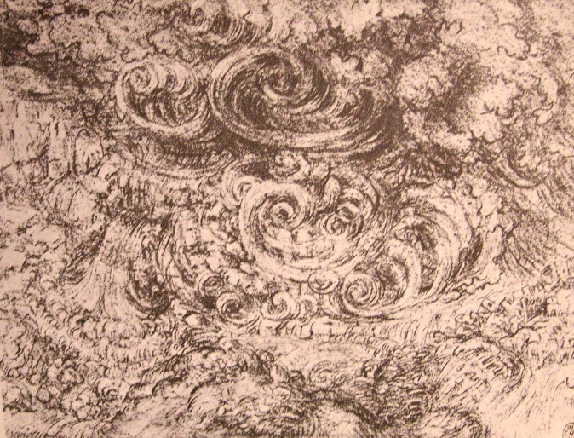
Léonardo da Vinci, Dessin du Déluge, 1517-18

Slide 3
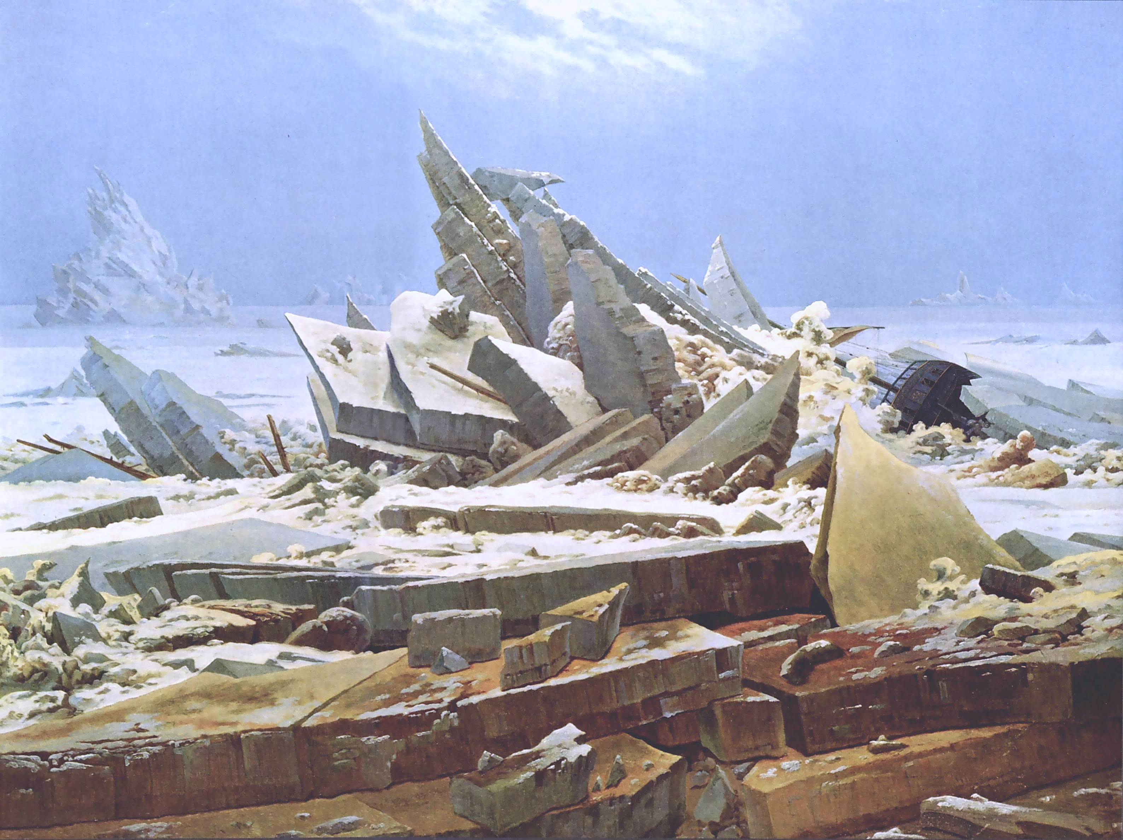
David Caspar Friedrich, The Sea of Ice (1823–24), Kunsthalle Hamburg. This scene has been described as "a stunning composition of near and distant forms in an Arctic image".^{[55]}

Slide 4
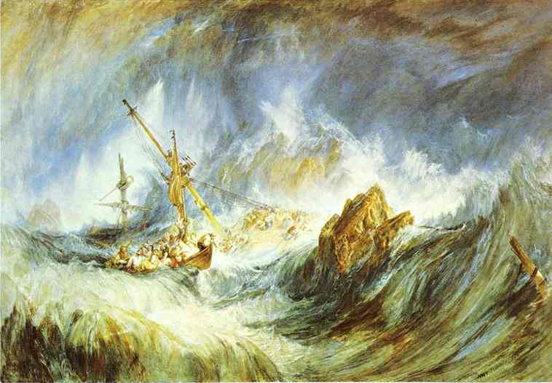
William Turner, Une tempête (naufrage), h/t

Slide 5
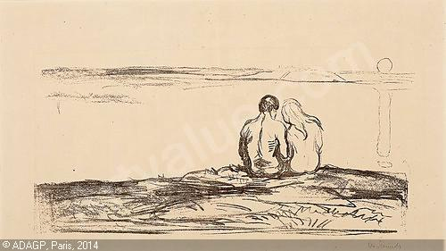
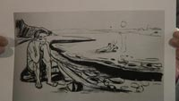
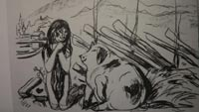
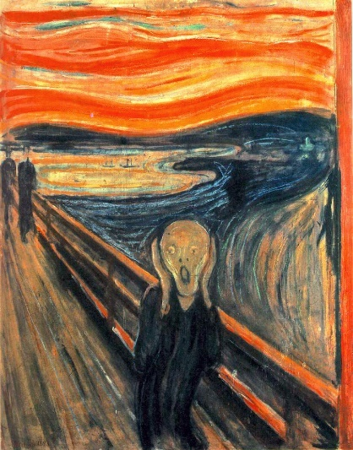
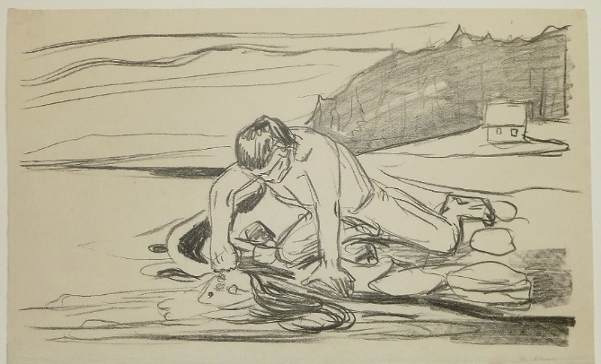
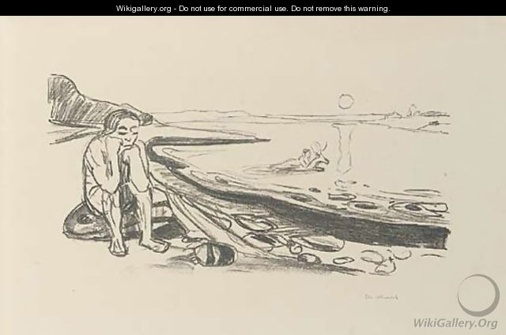
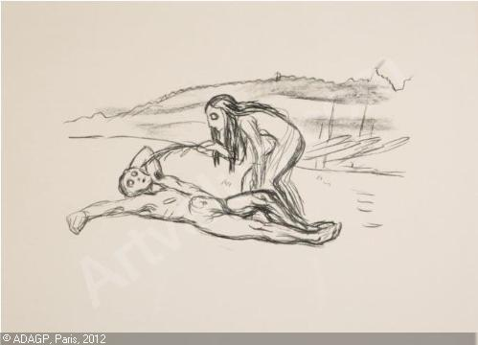
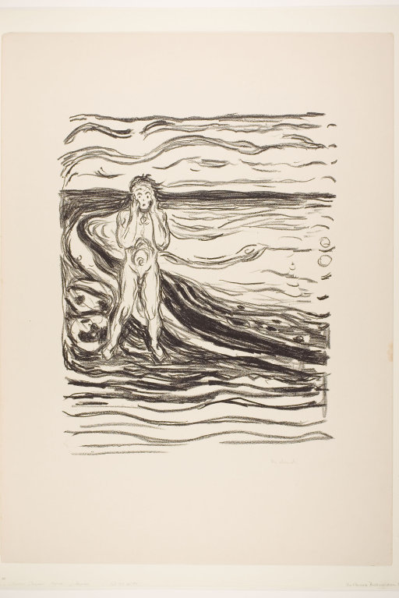
Edvard Munch, Alfa et Omega, 1910
1893
https://youtu.be/ciEFKcjSEPM

Slide 6
