Slide 1
SOME VERY LAST SLIDES… Prof. Dr. Andreas Bund Scientific Committee Facts and Statements of the 12th FIEP European Congress
Slide 1 of 12
Notes:
Dear colleagues and participants of the 12th FIEP European Congress!
I think it can be said that during the last few days of the congress we have spent an interesting and exciting time together. We have seen a lot of presentations of new research projects, new methods and approaches and we had a lot of productive talks with each other.
As a member of the scientific committee and to conclude the congress, I would like to try to give in some very last slides a short summary of the conference in terms of “facts and statements”. This happens, of course, from a very personal point of view and I have to point out that this summary of course does not necessarily include the “better” or “more important” contributions of the congress!

Slide 2
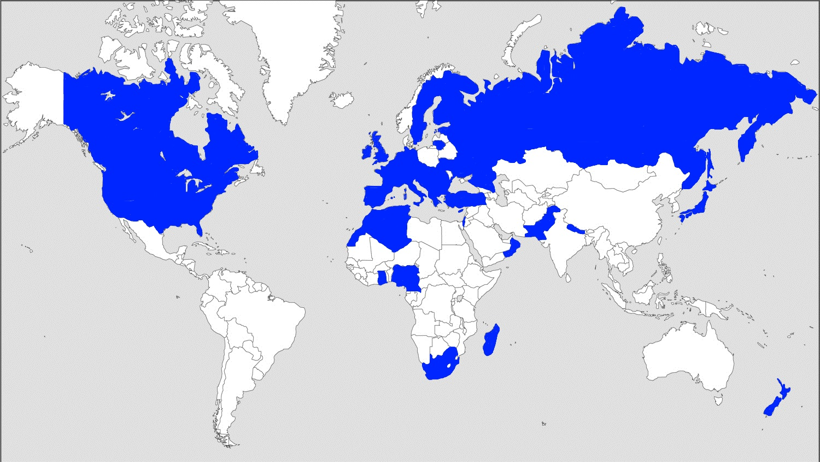
Facts… Approx. 200 participants from all over the world!
Slide 2 of 12
Notes:
Let’s begin with some facts of the 12th FIEP European Congress. First, the congress brought together about 200 researchers, teachers and stakeholders in the field of physical education from all over the world! As you can see on this map, we could welcome participants from Europe, Asia, Africa and North America. Thank you again for travelling so far to take part at this conference, we appreciate this very much!

Slide 3
Facts… 133 talks and posters in ⇒ 4 keynotes ⇒ 8 invited symposia ⇒ 14 parallel sessions ⇒ 1 poster session
Slide 3 of 12
Notes:
In the last three days, we had 133 talks and posters allocated to 4 keynotes, 8 invited symposia, 14 parallel sessions and 1 poster session (including the FIEP New Leaders session). The keynotes are of course always an essential part of a congress and therefore we are still proud that with Prof. Ina Hunger from Germany, Dr. Richard Bailey from the UK, Prof. Dr. Ivo van Hilvoorde from the Netherlands and Prof. Martin Block from the USA we could attract researchers who are internationally renowned as experts for his or her special topic of physical education. Thank you for joining us!
Furthermore, we are happy that a number of international organizations that are related to physical education has accepted our invitation to organize within the frame of the congress a symposium on a self-chosen topic. I think it can be stated today that due to the range and quality of the contributions these Invited Symposia have enriched the conference a lot.
However, the indispensable basis of each congress are the research projects presented in the parallel and poster sessions and we got a very positive feedback from a lot of people regarding these presentations. We would therefore like to thank all of the participants for presenting their research projects at this congress!

Slide 4
Facts… Research projects dealt with current topics of physical education ⇒ Physical Education in Early Childhood and Primary Education ⇒ Physical Education Teacher Education ⇒ Intercultural Learning and Inclusion in Physical Education ⇒ Physical Education and New Technologies ⇒ Physical Education and Physical Activity in Active School Communities ⇒ Physical Literacy ⇒ Physical Education in Secondary Education
Slide 4 of 12
Notes:
As you already know, all scientific contributions addressed at least one of seven important topics of current physical education:
Physical education in early childhood
Physical education teacher education
Intercultural learning and inclusion in physical education
Physical education and new technologies
Physical education and physical activity
Physical literacy
Physical education in secondary education
With the aim to give a very short (and of course incomplete) summary of the congress, I would like to present in the following some “key statements” given by participants on some of these topics.

Slide 5
Statements on… Physical Education in Early Childhood and Primary Education Keynote talk of Prof. Dr. Ina Hunger (Germany) ⇒ Type and extent of physical activity in early childhood strongly depends on social environment, i.e. the family. ⇒ Parents have conscious and unconscious educational values and goals. ⇒ Physical activity socialization in the family is commonly gender- biased, i.e., parents promote different learning opportunities to boys and girls.
Slide 5 of 12
Notes:
Let’s begin with the topic “Physical education in early childhood and Primary education”. In her keynote talk, Prof.nIna Hunger has stressed the importance of the social environment and especially of the family for the physical activity behavior in early childhood. In her qualitative research she worked out the educational values and goals that parents consciously or unconsciously follow and that frequently result in a gender-biased socialization in the field of sports and physical activity.

Slide 6
Statements on… Physical Education in Early Childhood and Primary Education European Primary Physical Education Network (EPPEN) ⇒ Increasing impact of stakeholders from politics, industry and public health on primary physical education. ⇒ Contradictory views about the purpose of primary physical education may hinder necessary developments. ⇒ EPPEN offers a platform to discuss these developments. ⇒ See also: European Physical Education Observatory project of EUPEA (Onofre).
Slide 6 of 12
Notes:
Thus, while Ina Hunger was dealing with the impact of the family context on children’s physical activity, the European Primary Physical Education Network (EPPEN) addressed in its symposia the increasing involvement of diverse stakeholders on primary physical education, for example from politics, industry or the public health sector. This development is seen critically by many researchers since it may result in conflicting views about the goals of physical education in primary schools and, thus, may slow down the development in this field. The European Primary Physical Education Network offers a platform to discuss these questions on a regular basis. In this context, it should also be noted that a new project of EUPEA, namely the European Physical Education Observatory project, is going to develop a comprehensive monitoring system for sports activities and physical education in schools.

Slide 7
Statements on… Intercultural Learning and Inclusion in Physical Education Keynote talk of Prof. Dr. Martin E. Block (USA) ⇒ Physical education teachers do not feel prepared to include students with disabilities into their physical education classes. ⇒ Many physical education teacher education programs do not have the space to add more classes and/or do not have pro- fessors with special knowledge. ⇒ Possible solution: Online training for future physical education teachers.
Slide 7 of 12
Notes:
Without doubt, how to include children with disabilities into general physical education lessons becomes more and more important. In his keynote speech, Prof. Martin Block stated that due to the lack of special courses in their educational programs, physical education teacher do not feel prepared to work with disabled children. Since many teacher education programs have neither the time nor the professors to offer additional courses in adapted physical education, he suggests to establish online training programs to provide relevant content to the students. First experience at the University of Virginia confirms that online training is suitable to teach students critical aspects of adapted physical education.

Slide 8
Statements on… Intercultural Learning and Inclusion in Physical Education UNESCO chair IT Trailee and diverse authors ⇒ iPEPAS project: Inclusive physical education, physical activity and sport – an online resource (Sugrue). ⇒ Learning about otherness in physical education is moderated by social interactions in the form of verbal and non-verbal commu- nication and results in a kind of “micro society” (Wane).
Slide 8 of 12
Notes:
Beside the keynote speech of Prof. Martin Block, further research on inclusion and intercultural learning was presented at this congress. For example, Aisling Sugrue presented the iPEPAS project of the UNESO what stands for Inclusive Physical Education, Physical Activity and Sport. iPEPAS, which is first of all an online resource, aims to bridge the gap between policy and praxis and to make it easier for disabled people to take part in physical education, physical activity and sport.
Using observation and interviews, Cheikh Wane investigated how secondary school students with different cultural backgrounds deal with the “otherness” among each other in the context of physical education and how they develop in a process of intercultural learning a kind of “micro society” in which a consensus exists about a set of common rules and values.

Slide 9
Statements on… Physical Education and New Technologies Keynote talk of Prof. Dr. Ivo van Hilvoorde (Netherlands) ⇒ Smartphones, tablets, apps, video games etc. have an impact on how children experience sports and physical activities. ⇒ The use of digital technologies in physical education must be based on technological, pedagogical, and content knowledge (TPACK) and critically reflected. ⇒ Examples of application are motor learning, evaluation and monitoring of motor development, assessment, etc.
Slide 9 of 12
Notes:
Finally, let’s take a look at one of the key topics of our congress, that is to say the use of new technologies in physical education. We heard an outstanding keynote talk of Prof. Ivo van Hilvoorde, in which he firstly stated that smartphones, tablets, apps and so on and the physical activities of children are already linked with each other in manifold ways. In fact, they have a significant impact on how children perform sports and physical activities. From his point of view, the benefit of using new technologies in physical education depends mainly from the technological, pedagogical and content knowledge of the physical education teacher and he named this as “TPACK” model. Motor skill learning or the evaluation and monitoring of motor abilities (that is, motor development) are typical examples of application of digital technologies in the field of physical education.

Slide 10
Statements on… Physical Education and New Technologies Fédération Internationale d’Éducation Physique (FIEP) and diverse authors ⇒ 41% of secondary school students think that digital technology should not be used in physical education (Luptáková & Antala). ⇒ GPS-based smartphone apps and games can be used to assess and stimulate physical activity of young people (Diketmüller). ⇒ Augmented reality is suitable to create effective and motivating balance exercises (Mast et al.). ⇒ Digital technology helps teacher to design “balanced” learning environments and motivating motor tests (Koekoek & Walinga; Zemková & Stefániková).
Slide 10 of 12
Notes:
Further research on this topic were presented at the invited symposia of FIEP and two parallel sessions. In a recent study of Gabriela Luptákowá & Branislaw Antala 41% of the secondary school students indicated that new technologies should not be used in physical education, although the students think that it could enhance the learning process and increase their motivation. According to Rosa Diketmüllers research, special apps and games on the smartphone can not only be used to assess the physical activity patterns of teenagers, but also stimulate them to be more active. And finally, technology helps teachers to create appropriate and motivating learning, exercise and test situations.

Slide 11
There are many other works that could and should be mentioned, but…
Slide 11 of 12
Notes:
Of course, there are so many other works that I could and should mention here, but we have to come to an end. (However, let me remind you that a full text book on this conference will be published soon).
Alltogether, I think it can be stated that this congress has showed a remarkable scientific level. A lot of new findings and approaches on current topics of physical education were presented and deeply discussed here. As we all know, the field of physical education faces a number of challenges raised by recent social, political and technological developments. My hope is that the results of this congress can help to address and cope these challenges! Perhaps we are already wiser concerning this point when we meet us again next year in Istanbul!

Slide 12
Thank you very much for your attention and for your participation at the 12th FIEP European Congress in Luxembourg!
Slide 12 of 12
Notes:
Thank you very much for your attention and for your participation at the 12th FIEP European Congress in Luxembourg!

