Slide 1
Experimental and numerical assessment of the mechanics of keloid-skin composites undergoing large deformations
M. Sensale, J. Chambert, F. Chouly, A. Lejeune, S. Joly, K. Rekik,
G. Rolin, T. Lihoreau, B. Chatelain, P. Sandoz, S. Bordas, E. Jacquet

Slide 2
table of contents
Keloid scars
Goal of the project
A clinical study on a keloid specimen
Parameters identification: hyperelasticity
Modelling: image processing, CAD modelling, FEM modelling
Results & Discussion
Prospects

Slide 3
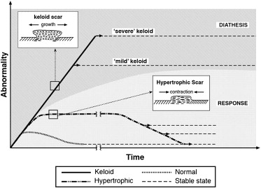
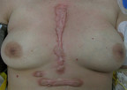
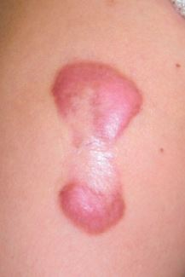
keloid scars (1)
“A keloid scar is defined as a dermal tumour that spreads beyond the margin of the original wound, that continues to grow over time, that does not regress spontaneously, that often recurs after excision, and has been present for at least 1 year.“ (Suarez Pozos, 2014)
Sternal keloid (Patel et al., 2010)
Upper arm keloid (Ogawa et al., 2011)
Keloid’s growth (Burd, 2008)

Slide 4
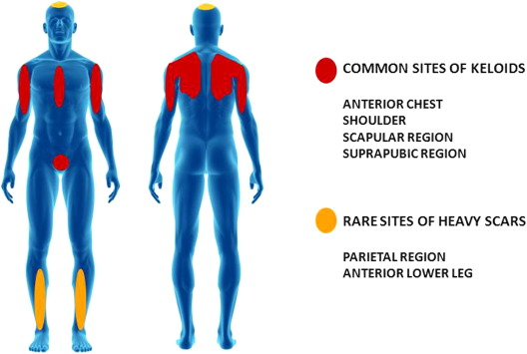
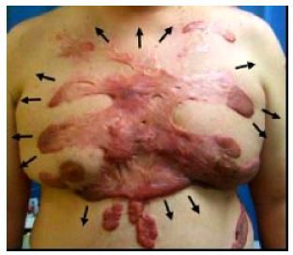
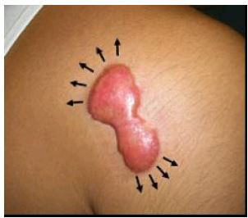
keloid scars (2)
Crab’s clow shape keloid (Ogawa, 2008)
Common sites of keloid appereance (Ogawa , 2011)
Biologic, genetic and mechanical causes
Pathogenesis still not well understood
No existing optimal treatment method
Butterfly shape keloid (Ogawa, 2008)

Slide 5
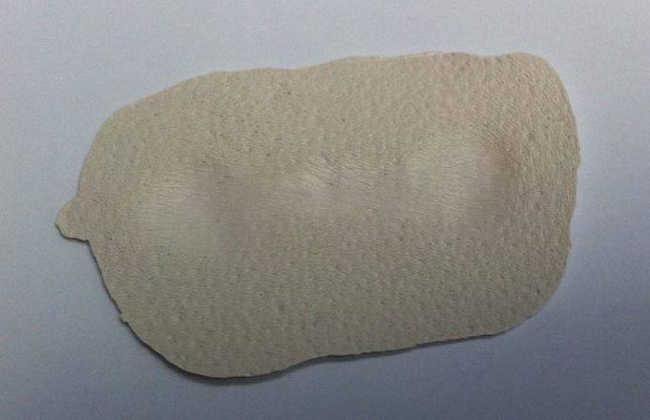
goal of the project
Hypothesis: mechanical forces are responsible of keloid’s extension
Develop a method to predict keloid mechanical behaviour
Investigate the stress field in and around the keloid and directions of growth
Design a patient-specific device to prevent keloid’s growth
aim of the present study
Develop a 3D FEM model of a real keloid starting from experimental data collected during a clinical study on a volunteer’s specimen.
Photo of the keloid’s specimen silicon molding

Slide 6
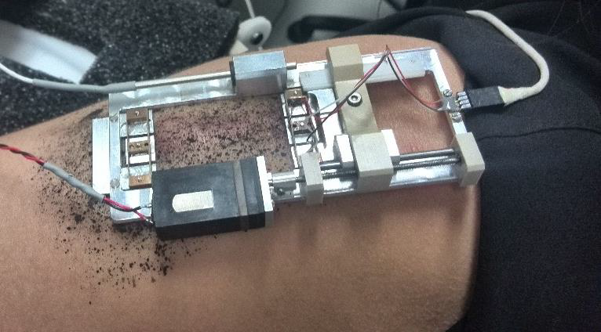
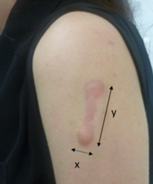
a clinical study on a keloid specimen (1)
Ultra-light extensiometer: uniaxial extension
Keloid specimen
A photo taken during the clinical study

Slide 7
a clinical study on a keloid specimen (2)
Ultra-light extensiometer: uniaxial extension
Moving pad,
force sensor
Fixed pad
A photo taken during the clinical study

Slide 8
a clinical study on a keloid specimen (2)
Ultra-light extensiometer: uniaxial extension
U-shaped fixed guarding pad
U-shaped moving guarding pad
A photo taken during the clinical study

Slide 9
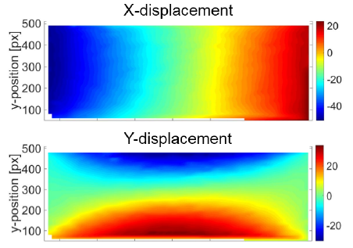
a clinical study on a keloid specimen (3)
Ultra-light extensiometer: uniaxial extension
Displacement fields following the tensile axis X and the transverse axis Y for an example with only healthy skin

Slide 10
a clinical study on a keloid specimen (4)
Hypothesis:
constant keloid thickness $e_{0}$
constant healthy skin thickness $e_{0}^{′}$
uniform strain over both keloid and healthy skin
$σ=\frac{F}{d∙e_{0}}$; $ε= \frac{L−L_{0}}{L_{0}}$

Slide 11
parameters identification: hyperelasticity(1)
Mechanical parameters identification: ANSYS® Material Curve Fitting
Least squares fitting hypothesizing a uniaxial traction:
$$E= \sum_{i=1}^{N}{{\left(σ_{i}^{exp} − σ_{i}^{p}(c_{j})\right)}^{2}}$$
Hypothesis about keloid and healthy skin materials:
Ideally elastic (no visco-elasticity)
Isotropic
Homogeneous
Incompressible
Hyperelastic (nearly incompressible $K=570 MPa$)
$$\frac{∂}{∂C}$$
W strain density energy function
Stress $σ_{i}^{p}$

Slide 12
parameters identification: hyperelasticity(2)
Mechanical parameters identification: ANSYS® Material Curve Fitting
Mooney-Rivlin 5 parameters model
Mooney-Rivlin 5 parameters (MPa)
 | Keloid | Healthy skin
C10 | - 0.97 | - 0.01
C01 | 0.98 | 0.02
C20 | 912.30 | 9.34
C11 | -1953.40 | - 21.36
C02 | 1048 | 12.24
$W= {W(c}_{10}, c_{01}$, $c_{20}{, c}_{11}$, $c_{02}, d,\text{I}\text{1}\text{, }\text{I}\text{2}\text{, }\text{I}\text{3}$)
c₁₀, c₀₁, c₂₀, c₁₁, c₀₂ material constants
d compressibility parameter
I₁, I₂, I₃ invariants of the Cauchy-Green tensor
Ogden 2nd order model
Ogden 2° order (MPa)
 | Keloid | Healthy skin
μ₁ | 5.07 E-06 | 9.40 E-09
α₁ | 83.03 | 64.38
μ₂ | 7.20 | 0.01
α₂ | 0.01 | 4.90
$$W=W( μ_{1},α_{2},μ_{2},α_{2},d_{1},d_{2},{\overline{λ}}_{p}\left(p=1,2,3\right))$$
μ₁, α₁, μ₂, α₂, material constants
d_{1,} d₂ compressibility parameters
$\overline{λ}p (p=1,2,3)$ principal stretches of the deviatoric part of the deformation gradient tensor

Slide 13
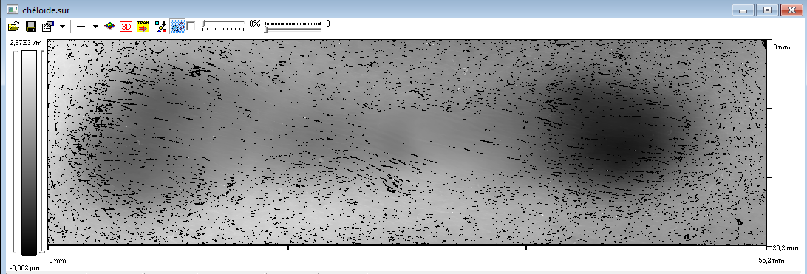
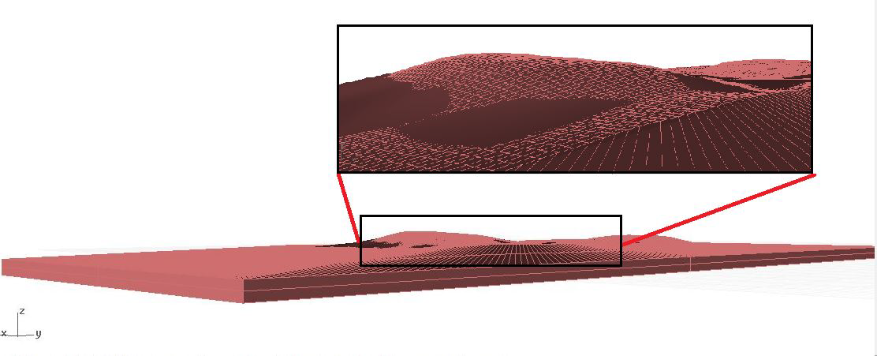
image processing
Alicona Infinite Focus ® : image of the silicon molding (55x20 ${mm}^{2}$)
CAD modelling
3d model of a keloid scar (100x40 ${mm}^{2}$) , Rhinoceros ©

Slide 14
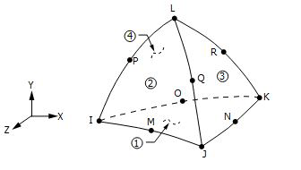
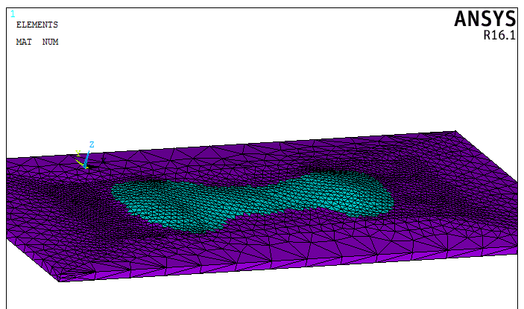
FEM modelling (1)
Element SOLID187
Quadratic tetrahedra
Translations x, y, z directions
Unstructured meshes
Geometry of element SOLID187 ANSYS®
Composite keloid / healthy skin
An example of mesh, element size (0.9-1.1) mm

Slide 15
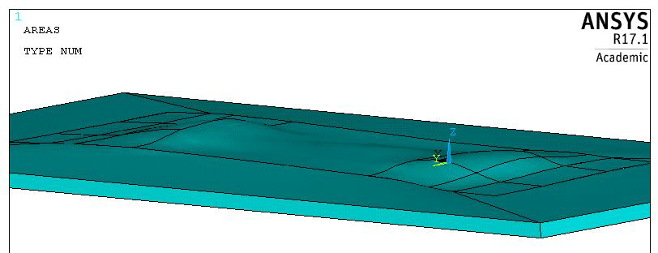
FEM modelling (2)
Moving pads: $u_{x}=−4.119 mm; u_{y}=u_{z}=0$
Fixed pads: $u_{x}=u_{y}=u_{z}=0$
Dermis: $u_{z}=0$
Boundary conditions
Nonlinear analysis ➔ Newton-Raphson linearization method
Dirichlet boundary conditions applied on some surfaces of the model

Slide 16
results and discussion (1)
Numerical curves fit well experimental curve up to about 3 mm
Composite model is less stiff because of the contribution of healthy skin around the keloid

Slide 17
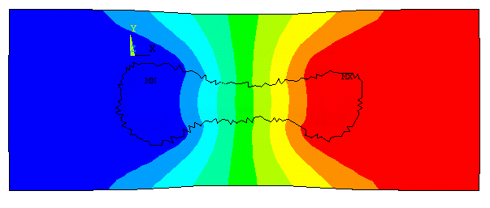
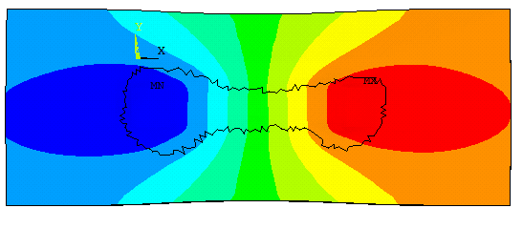
results and discussion (2)
U-shaped guarding pads boundary conditions
$u_{x}$ field with guarding pads BCs
Correlation coefficients:
All BCs ➔ r = 0.9877
Without U pads BCs ➔ r = 0.9729
$u_{x}$ field without guarding pads BCs

Slide 18
prospects (1)
Constant keloid and healthy skin thickness
Uniform strain
Only uniaxial extension
Uncertainty quantification and sensitivity analysis about mechanical parameters in FEniCS ©
Absence of experimental data about the interface keloid / healthy skin
Need data from OCT, echography, cutometry test
Pre-tension
Anisotropic models
Isotropy

Slide 19
prospects (2)
Effect of dermis underneath the model
Study of sensibility
Tests on a phantom fabricated using a developed mold
Boundary conditions
Estimate of the experimental stress field with Digital Image Correlation
Comparison with numerical results

Slide 20
Thank you for your attention
Marco Sensale

Slide 21
results and discussion (3)

