Slide 1
Dipl.-Ing. Mark Michael
2010 - 2014 University of Luxembourg
PhD at the Department of Thermo-/ Fluid Dynamics, FSTC
Degree Thesis
- A Discrete Approach to Describe the Kinematics between Snow and a Tire Tread
2003 - 2009 University of Rostock
Dipl.-Ing. (MSc) in Mechanical Engineering, Structure and Fluid Mechanics
Degree Thesis
- Determination of the Wake Structure and Surface Forces in the Flow around an Undulating Bluff Body by
means of Direct Numerical Simulation
2008 - 2009 Institute of Fluid Mechanics, Uni. Rostock Project: DFG Priority Programme 1147 Imaging Measurement Methods for Flow Analysis Experimental investigation of the flow structures of free jet flow striking the slope of a flat plate Numerical analysis of transient flow topology in the wake of a harbour seal whisker
2007 – 2008 Institute of Machine Dynamics, Uni. Rostock
Project: VibKom – Enhance comfort by improving the prediction of global and local vibrations of ship superstructures
2006 - 2007 Turbocharger Engineering Basic Development at MAN DIESEL SE Numerical vibration analysis, Contact load, Transient thermal loads, Fracture Mechanics of turbines
Notes:
1

Slide 2
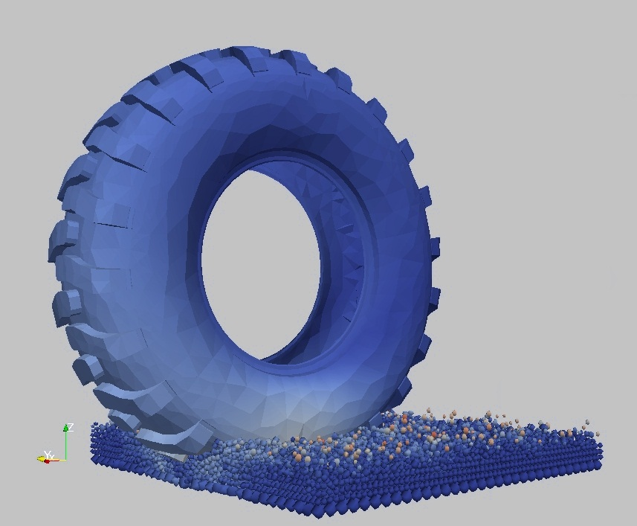
AN EFFICIENT 3D DEM–FEM COUPLING FOR GRANULAR MATTER APPLICATIONS
MARK MICHAEL – XDEM.DE – NAFEMS 2013
Notes:
2

Slide 3
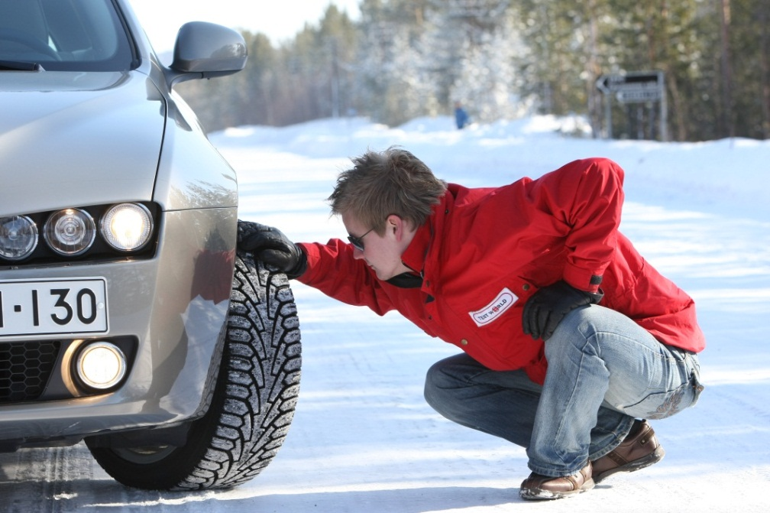
MOTIVATION
A simulation technique that describes the interaction between a tire tread and a snow covered road
Image Source: Test World Oy, Ivalo (Finland) www.testworld.fi
Ranges of Interest
Snow Temperature -30 to 0ºC
Snow Density 200 to 600 kg/m³
Impact Velocity 10⁻³ to 10¹ m/s
Applied Loads 10⁴ to 10⁷ Pa
MARK MICHAEL – XDEM.DE – NAFEMS 2013
Notes:
3

Slide 4
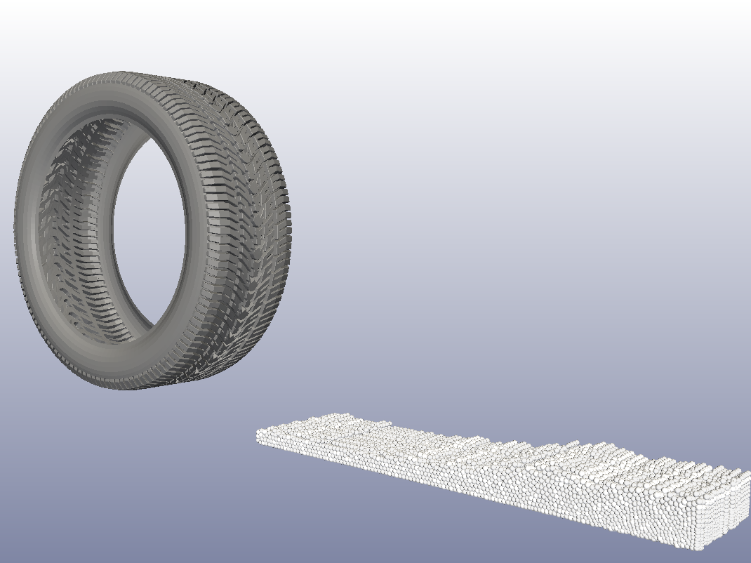
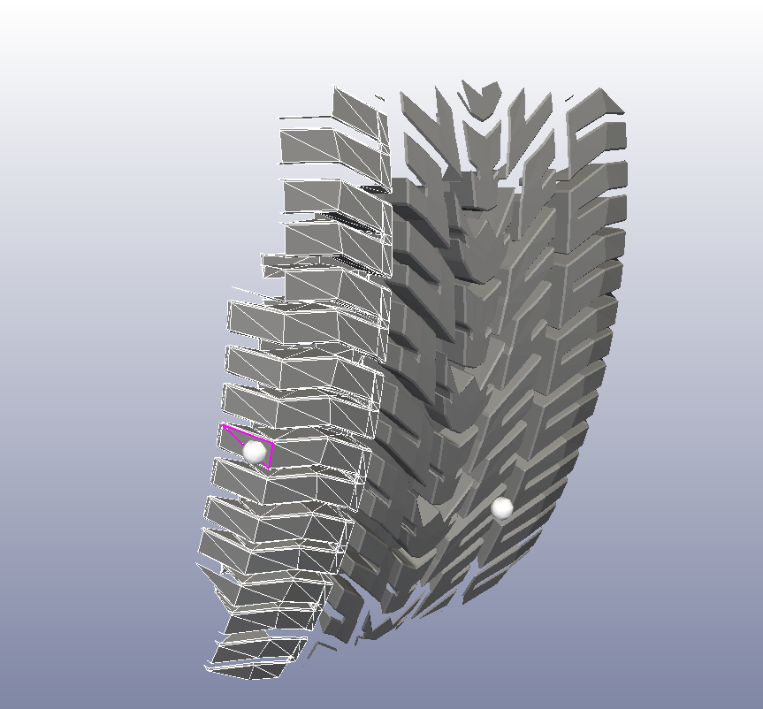
TECHNIQUE AND INNOVATION
Finite Element Method
for Tread Deformation
Interface Coupling of Loads and Deformation
Extended Discrete Element Method
for Grain Motion
MARK MICHAEL – XDEM.DE – NAFEMS 2013
Notes:
4

Slide 5
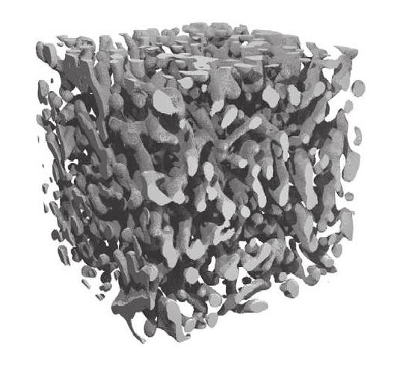
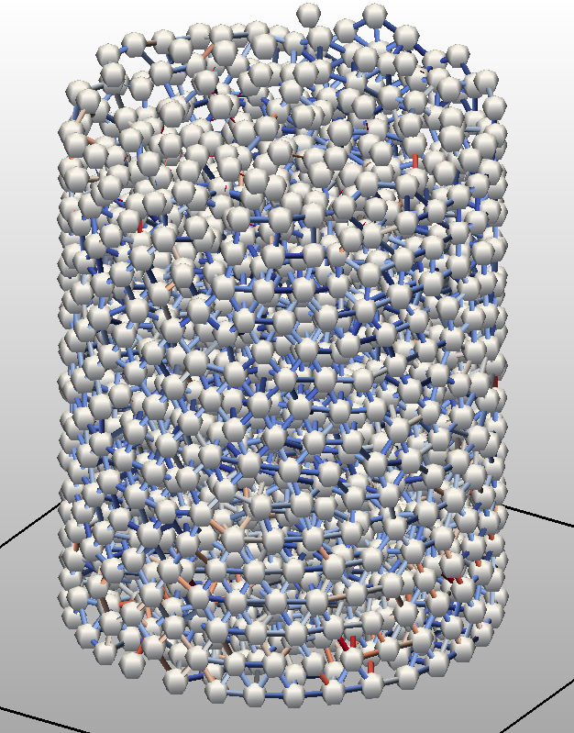
NATURE TO NUMERIC
Ice Matrix of Snow
Numerical Snow Sample
Spherical Grains + Cylindrical Bonds
modeling
X-ray microtomographie scans by Schneebelli (SLF Davos)
MARK MICHAEL – XDEM.DE – NAFEMS 2013
Notes:
5

Slide 6
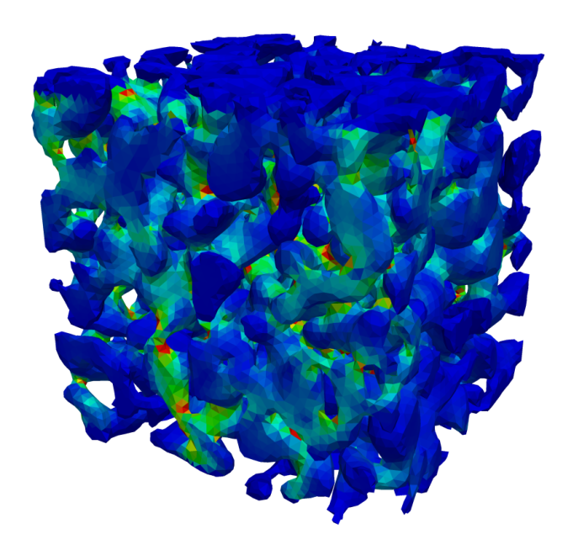
NATURE TO NUMERIC
Ice Matrix of Snow
Stress distriution in finite ice matrix
Numerical Snow Sample
Stress distriution in cylindrical bonds
FEM by P. Hagenmuller (IRSTEA Grenoble)
MARK MICHAEL – XDEM.DE – NAFEMS 2013
Notes:
6

Slide 7
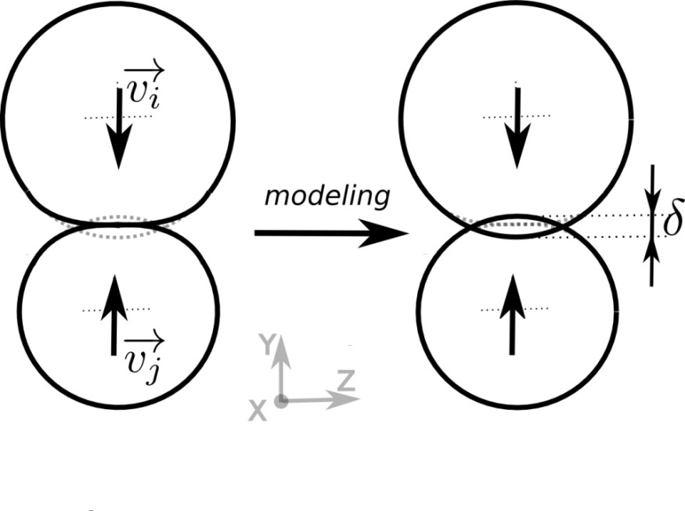
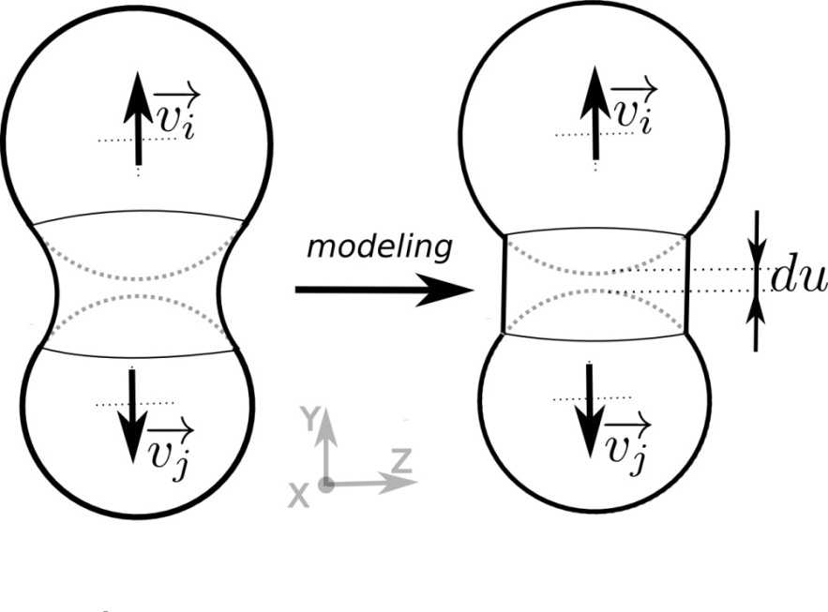
EXTENDED DISCRETE ELEMENT METHOD
Collision
Bonding
MARK MICHAEL – XDEM.DE – NAFEMS 2013
Notes:
7

Slide 8
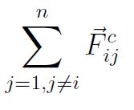
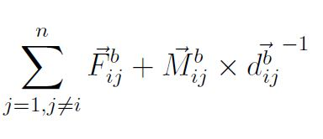
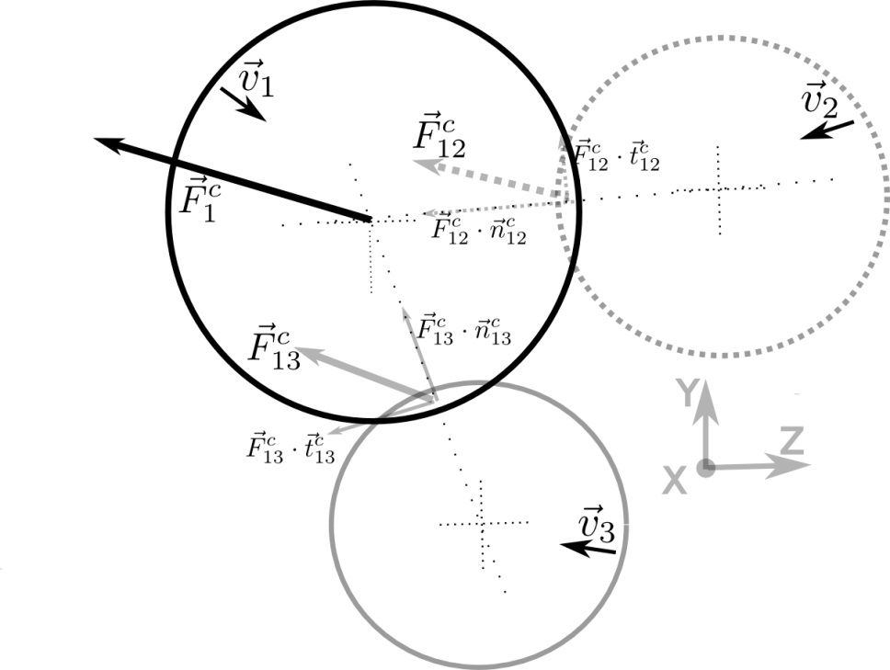
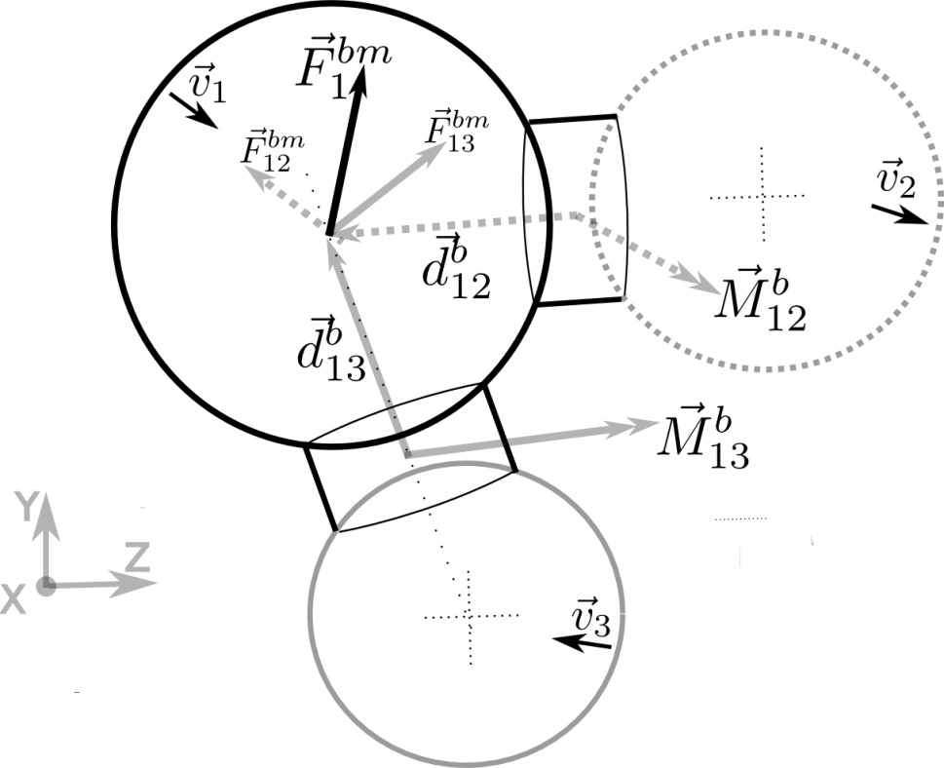
EXTENDED DISCRETE ELEMENT METHOD
MARK MICHAEL – XDEM.DE – NAFEMS 2013
Notes:
8

Slide 9
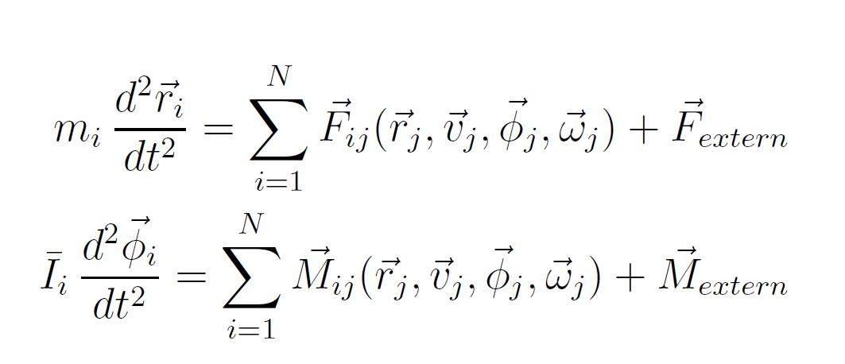
EXTENDED DISCRETE ELEMENT METHOD
Integration of Newton’s second law to yield new position and orientation
V_{t}
V_{t-3}
MARK MICHAEL – XDEM.DE – NAFEMS 2013
Notes:
9

Slide 10
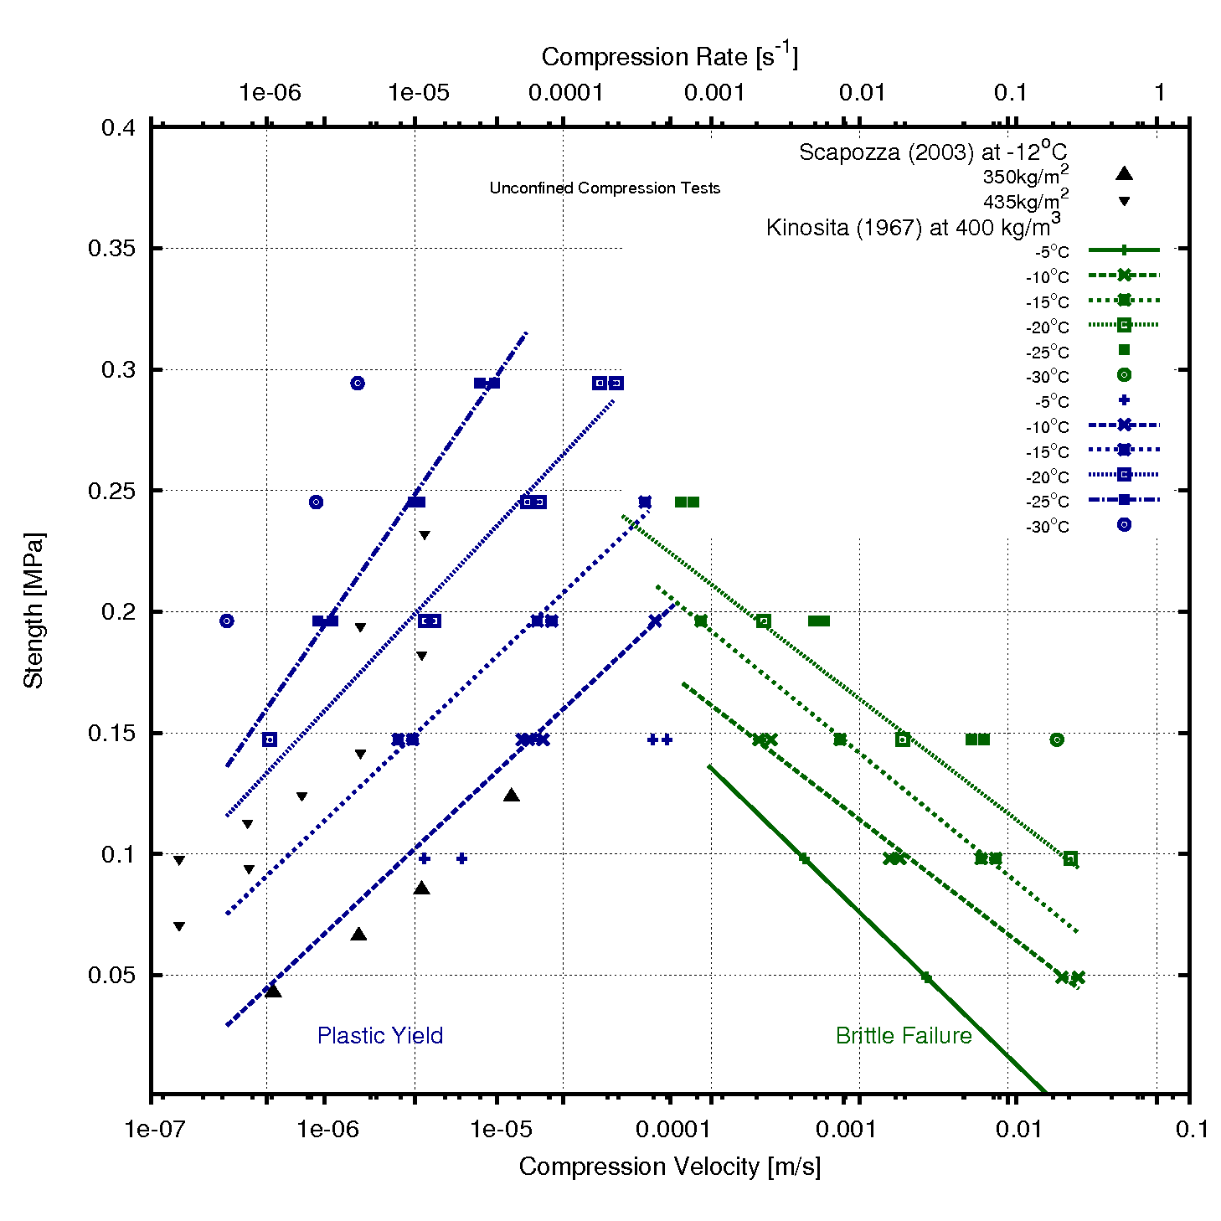
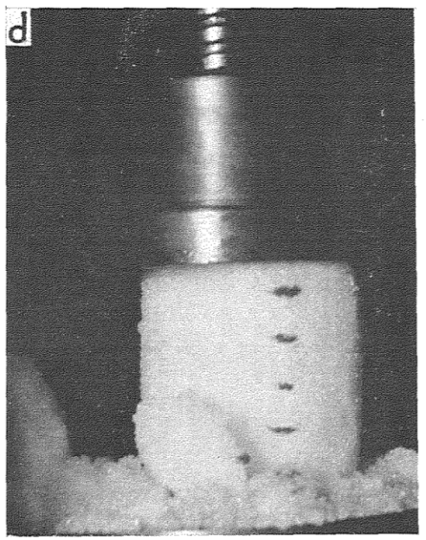
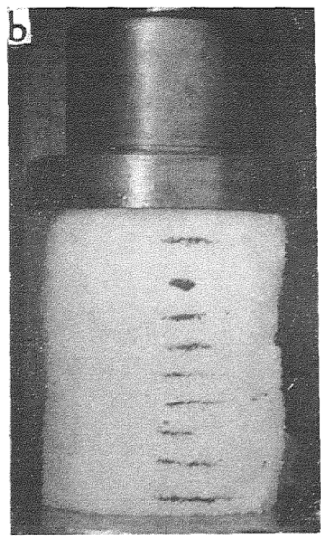
DUCTILE-BRITTLE TRANSITION OF SNOW
~10⁻⁴s⁻¹
Ductile Failure
Brittle Behaviour
Kinosita (1967)
MARK MICHAEL – XDEM.DE – NAFEMS 2013
Notes:
10

Slide 11
DUCTILE-BRITTLE TRANSITION OF SNOW
Ductile Failure
10⁻⁶s⁻¹
Brittle Behaviour
10⁻²s⁻¹
MARK MICHAEL – XDEM.DE – NAFEMS 2013
Notes:
11

Slide 12
DUCTILE-BRITTLE TRANSITION OF SNOW
Ductile Failure
10⁻⁶s⁻¹
Brittle Behaviour
10⁻²s⁻¹
MARK MICHAEL – XDEM.DE – NAFEMS 2013
Notes:
12

Slide 13
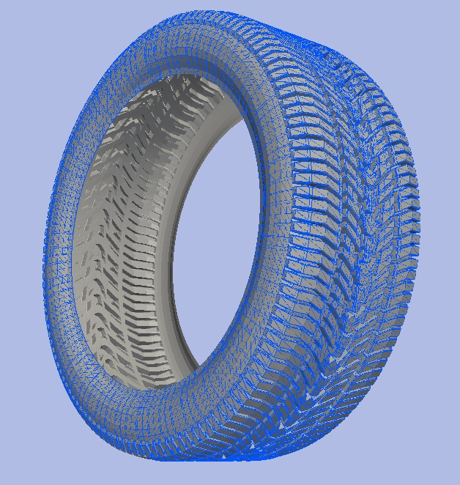
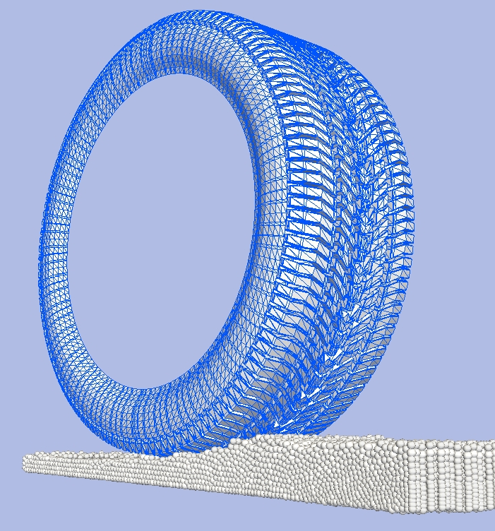
INTERFACE COUPLING
Surface Elements in FEM = Boundary Elements in DEM
MARK MICHAEL – XDEM.DE – NAFEMS 2013
Notes:
13

Slide 14
RIGID TREAD – TERRAIN INTERACTION
MARK MICHAEL – XDEM.DE – NAFEMS 2013
Notes:
14

Slide 15
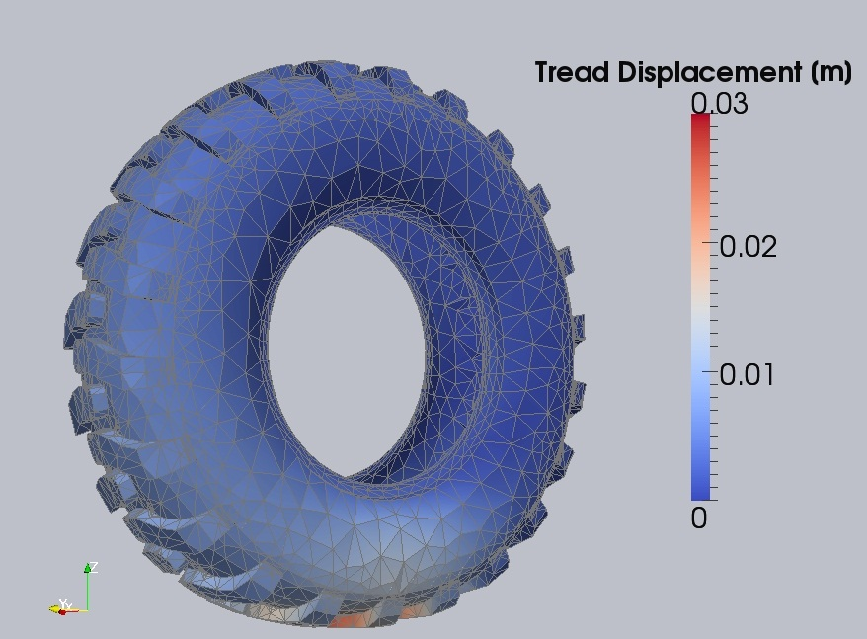
FINITE ELEMENT METHOD
Newton’s second law including internal force term and Hook’s linear elastic law
MARK MICHAEL – XDEM.DE – NAFEMS 2013
Notes:
15

Slide 16
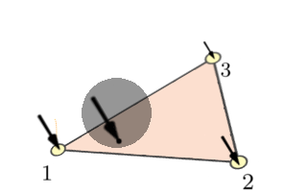
XDEM - FEM COUPLING PROCEDURE
F_{t}
F_{n}
-F_{n}
Interpolation of forces by means of FE shape functions
-F_{t}
-F
Transfer of counterpart force
Prediction of impact force on boundary on DEM side
MARK MICHAEL – XDEM.DE – NAFEMS 2013
Notes:
16

Slide 17
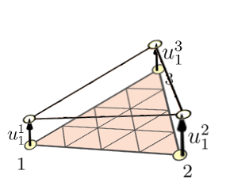
XDEM - FEM COUPLING PROCEDURE
Z
Y
u²
Transfer displacement vectors
Prediction of displacement at element nodes by means FEM solver
u
u¹
x_{j}
Update of position of boundary shape on DEM side
u³
MARK MICHAEL – XDEM.DE – NAFEMS 2013
Notes:
17

Slide 18
XDEM - FEM COUPLING
Spherical and cubical particles impacting elastic membrane
MARK MICHAEL – XDEM.DE – NAFEMS 2013
Notes:
18

Slide 19
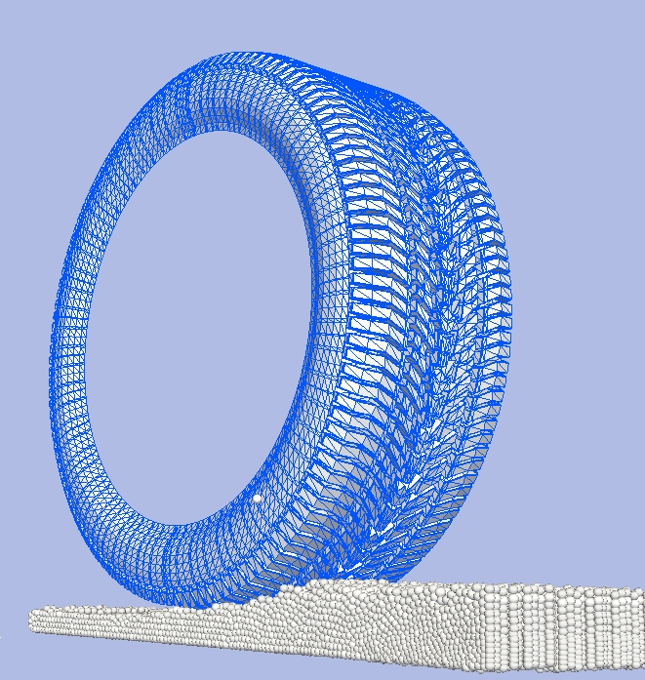
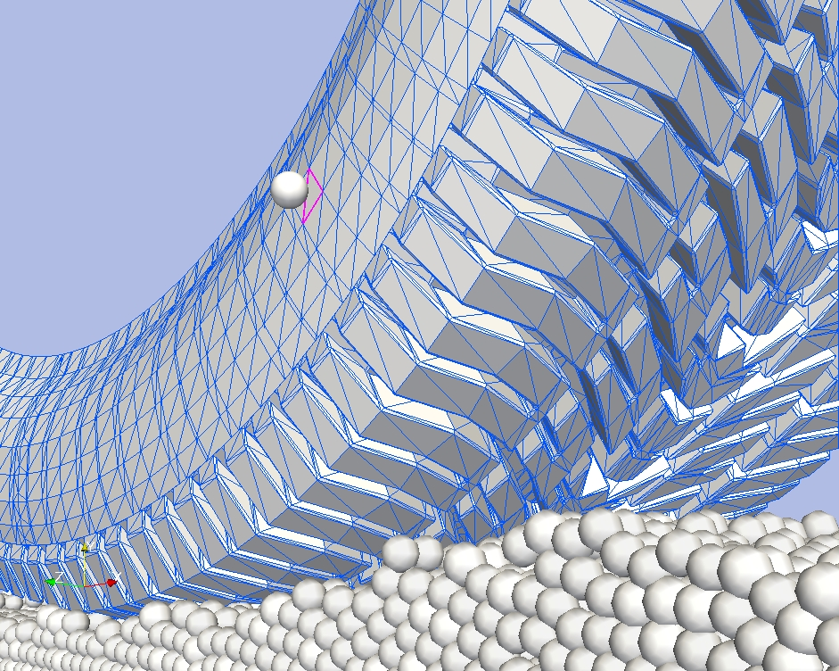
CONTACT DETECTION ALGORITHM
Detection of the intersecting boundary element
Particle
MARK MICHAEL – XDEM.DE – NAFEMS 2013
Notes:
19

Slide 20
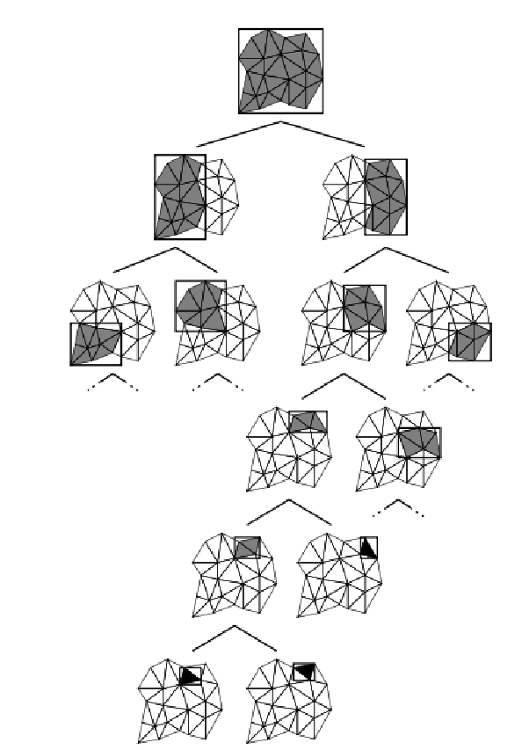
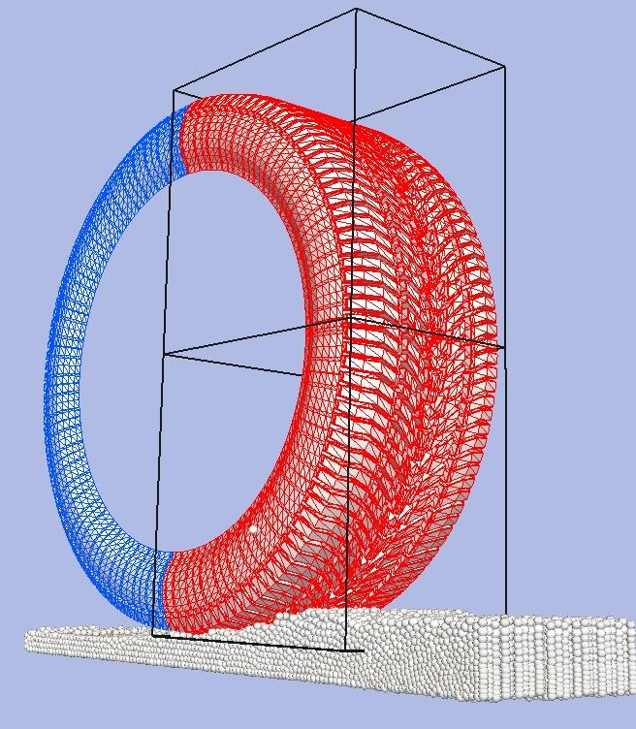
CONTACT DETECTION ALGORITHM
Detection of the intersecting boundary element
Split and predicted intersection with child bounding volume
Binary tree storing of bounding volume
who encapsulate boundary elements
MARK MICHAEL – XDEM.DE – NAFEMS 2013
Notes:
20

Slide 21
CONTACT DETECTION ALGORITHM
Bottom of binary tree
One bounding volume contains one element
Particle
Binary tree storing of bounding volume
who encapsulate boundary elements
Intersecting boundary element
MARK MICHAEL – XDEM.DE – NAFEMS 2013
Notes:
21

Slide 22
XDEM - FEM COUPLING
Tire – Soil Terrain Interaction
MARK MICHAEL – XDEM.DE – NAFEMS 2013
Notes:
22

Slide 23
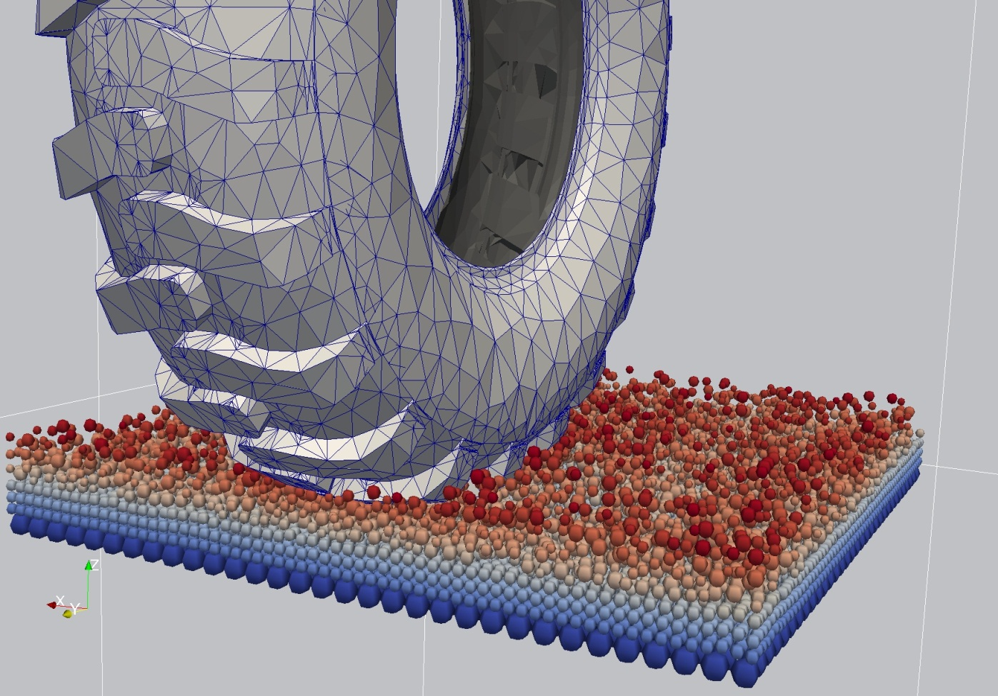
THANK YOU FOR YOUR ATTENTION
Visit us on www.XDEM.de
MARK MICHAEL – XDEM.DE – NAFEMS 2013
Notes:
23

